Slide 1
ELEMENTARY COMBINATORICS & PROBABILITY
Probability of an event

Slide 2
Last time
Random experiments
Sample space
Events
Probability of an event

Slide 3
TODAY
Problem set 6
More pen-and-paper exercises
Python exercises

Slide 4
Warm-up

Slide 5
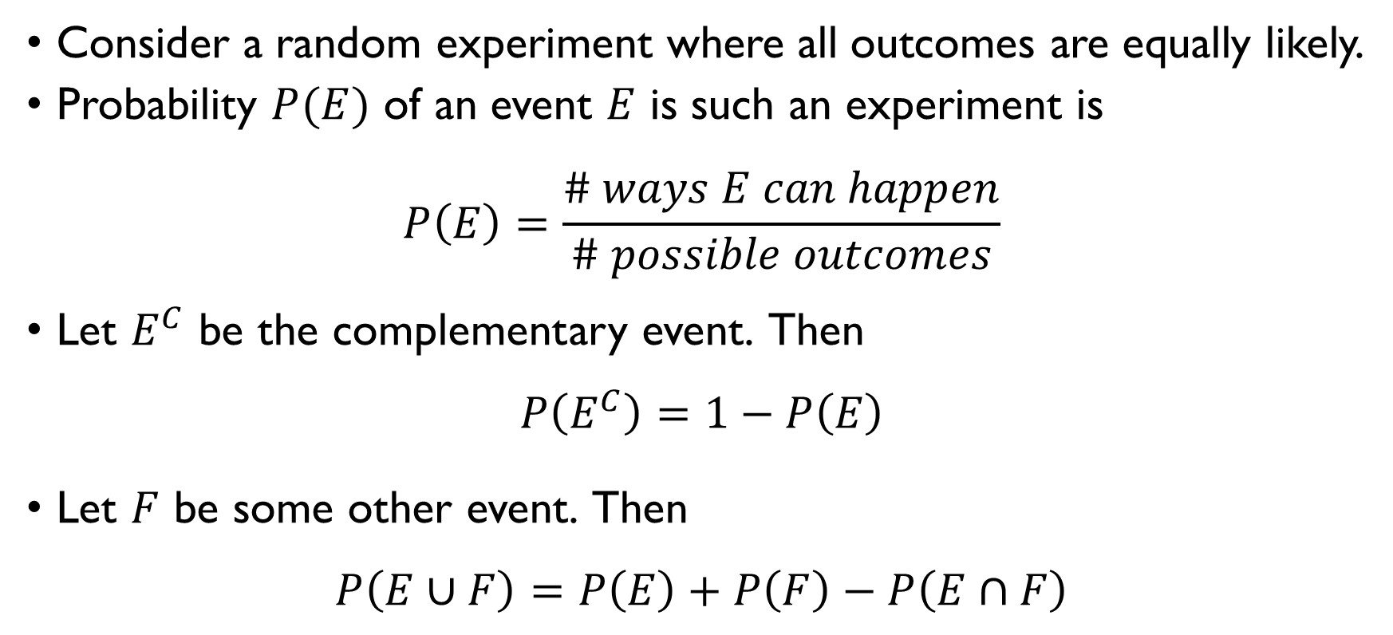
Probability of an event
Consider a random experiment where all outcomes are equally likely.
Probability $P(E)$ of an event $E$ is such an experiment is
$$P\left(E\right)=\frac{\# ways E can happen}{\# possible outcomes}$$
Let $E^{C}$ be the complementary event. Then
$$P\left(E^{C}\right)=1−P\left(E\right)$$
Let $F$ be some other event. Then
$$P\left(E∪F\right)=P\left(E\right)+P\left(F\right)−P\left(E∩F\right)$$

Slide 6
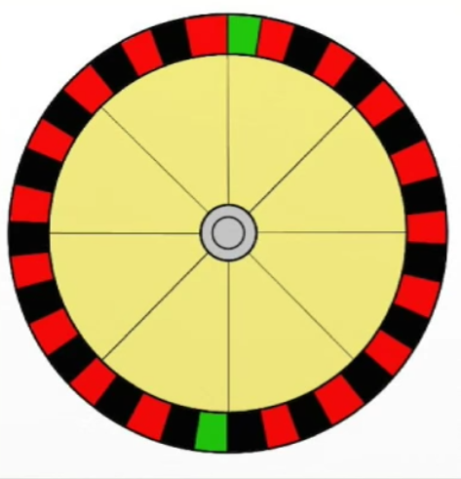
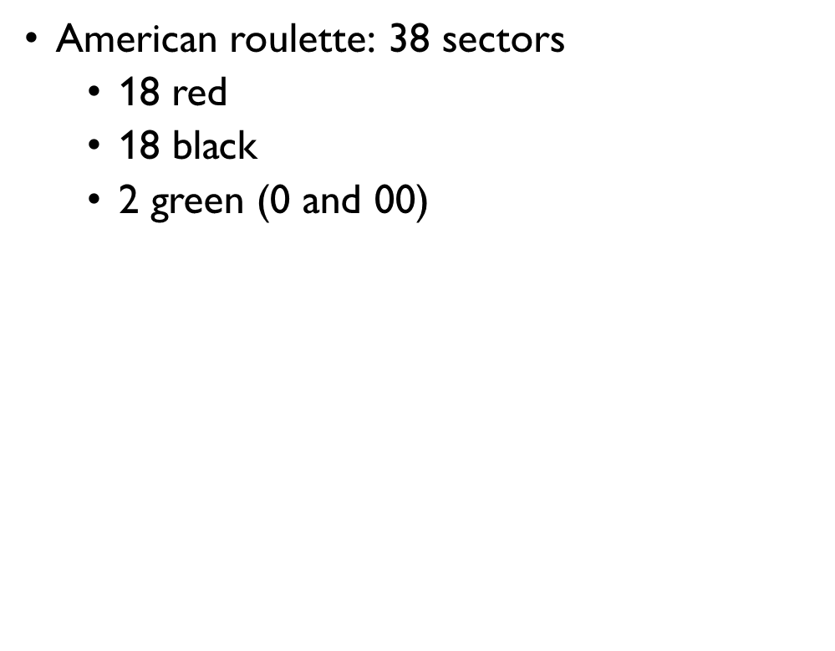
ROULETTE
American roulette: 38 sectors
18 red
18 black
2 green (0 and 00)
What is the probability to win if you
Bet on red $P\left(win\right)=18/38≈0.474$
Bet on black $P\left(win\right)=18/38≈0.474$
Bet on green $P\left(win\right)=2/38≈0.05$

Slide 7
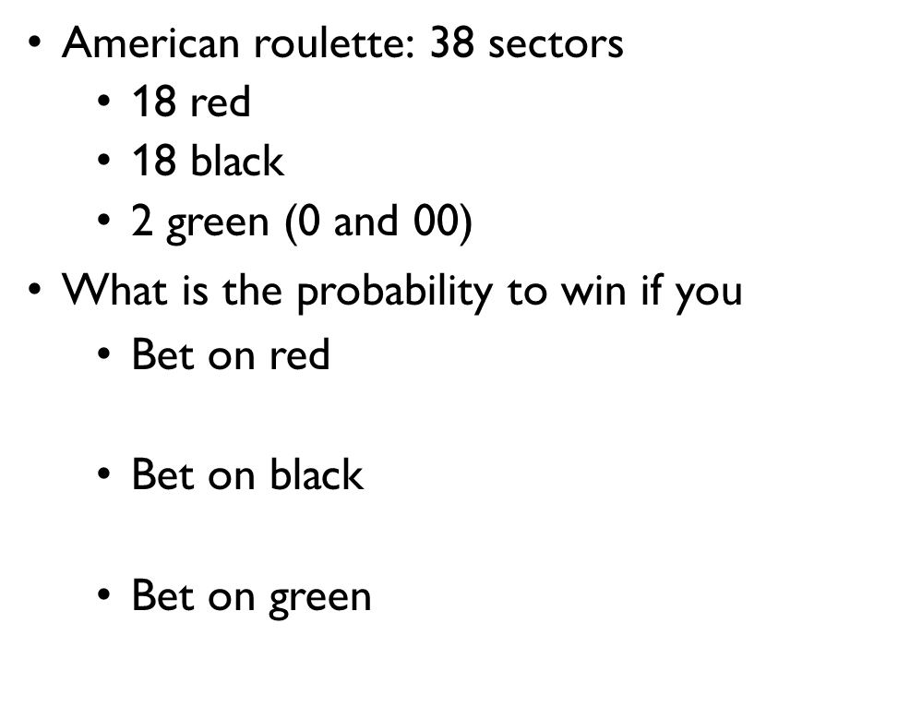
ROULETTE
American roulette: 38 sectors
18 red
18 black
2 green (0 and 00)
What is the probability to win if you
Bet on red $P\left(win\right)=18/38≈0.474$
Bet on black $P\left(win\right)=18/38≈0.474$
Bet on green $P\left(win\right)=2/38≈0.05$

Slide 8
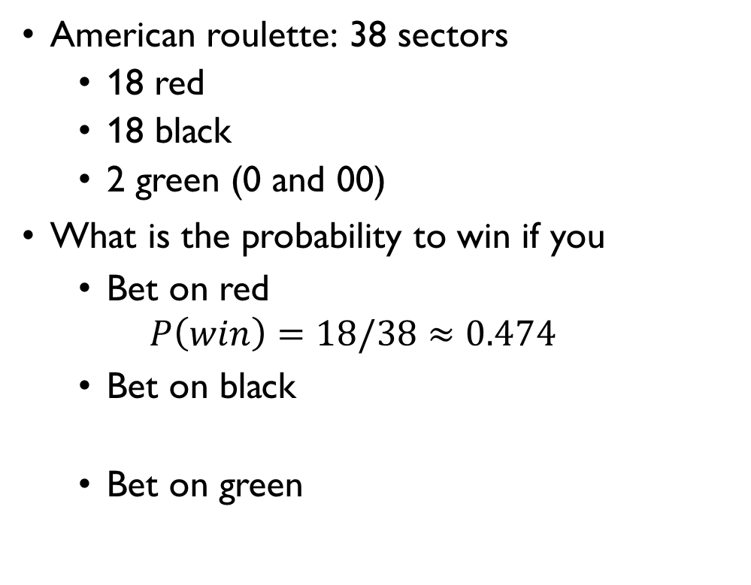
ROULETTE
American roulette: 38 sectors
18 red
18 black
2 green (0 and 00)
What is the probability to win if you
Bet on red $P\left(win\right)=18/38≈0.474$
Bet on black $P\left(win\right)=18/38≈0.474$
Bet on green $P\left(win\right)=2/38≈0.05$

Slide 9
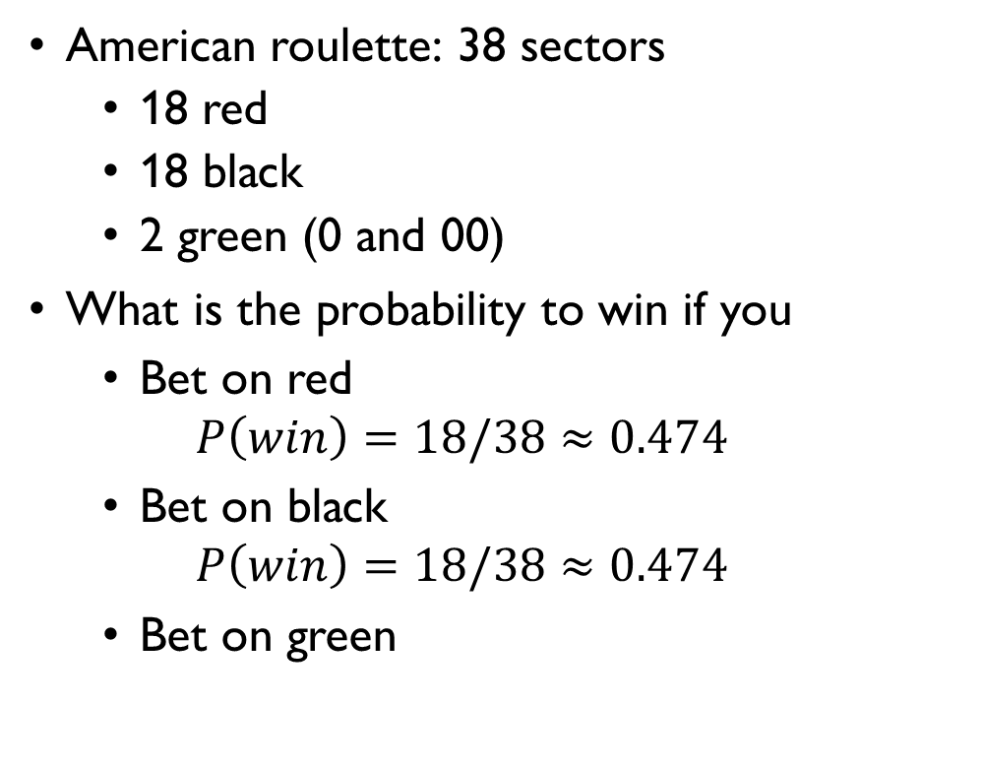
ROULETTE
American roulette: 38 sectors
18 red
18 black
2 green (0 and 00)
What is the probability to win if you
Bet on red $P\left(win\right)=18/38≈0.474$
Bet on black $P\left(win\right)=18/38≈0.474$
Bet on green $P\left(win\right)=2/38≈0.05$

Slide 10
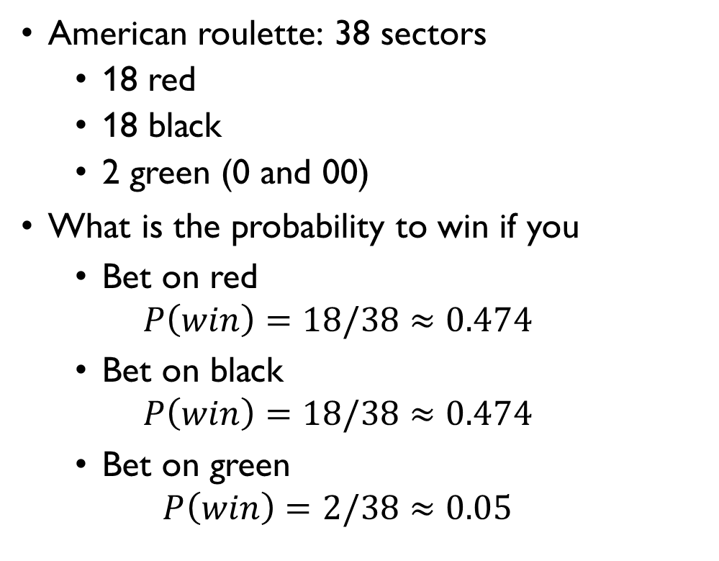
ROULETTE
American roulette: 38 sectors
18 red
18 black
2 green (0 and 00)
What is the probability to win if you
Bet on red $P\left(win\right)=18/38≈0.474$
Bet on black $P\left(win\right)=18/38≈0.474$
Bet on green $P\left(win\right)=2/38≈0.05$

Slide 11
Problem set 6
Selected problems

Slide 12
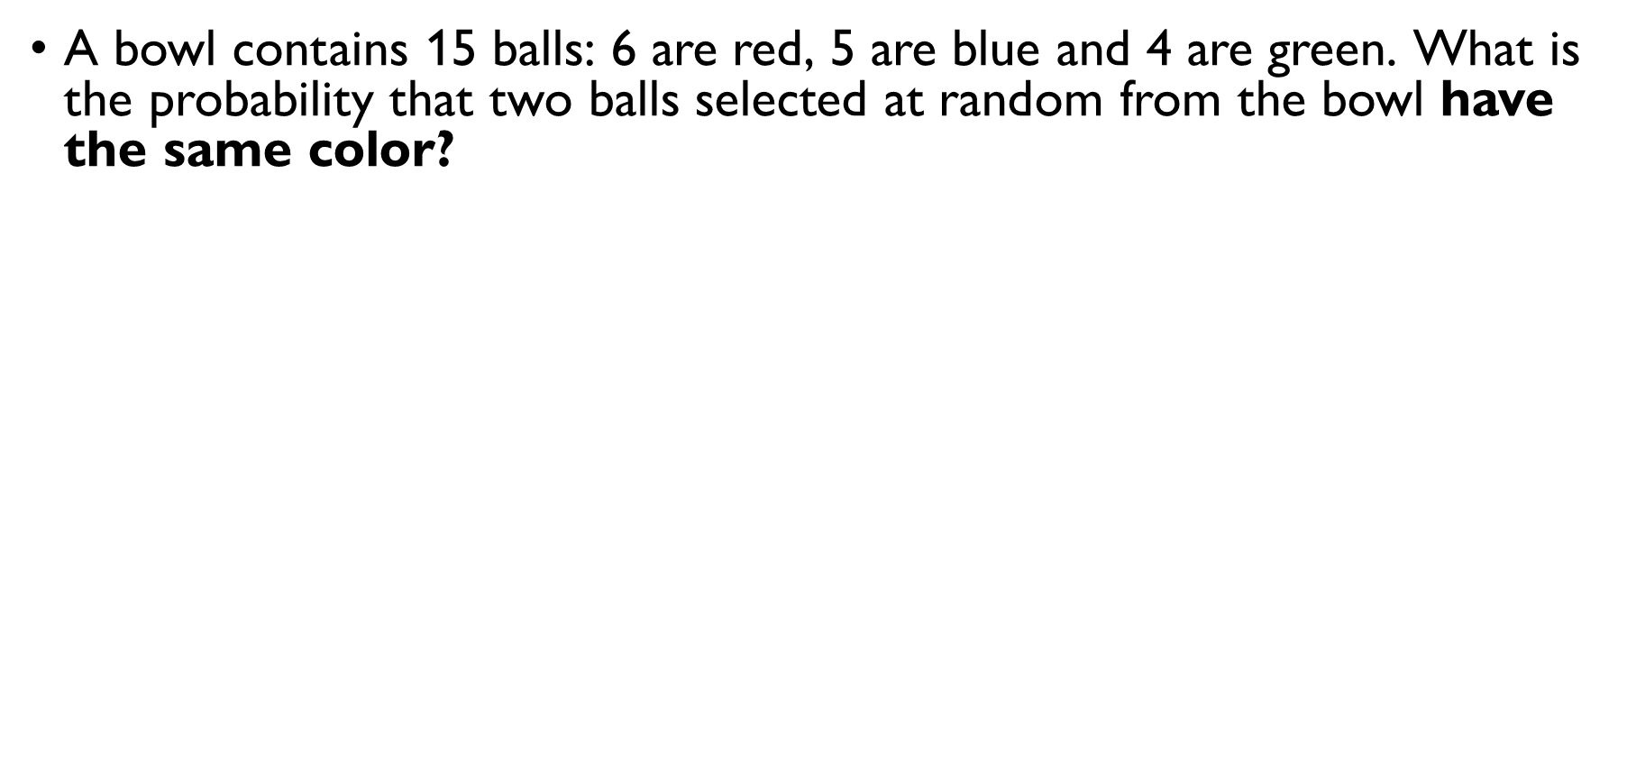
Balls from a bowl
A bowl contains 15 balls: 6 are red, 5 are blue and 4 are green. What is the probability that two balls selected at random from the bowl have the same color? Method 1: combinations (grabbing 2 balls at the same time)
$\left|S\right|=C\left(15, 2\right)=\frac{15!}{2!13!}=105$ ways to choose 2 balls out of 15
$$\left|E\right|=\left|E_{2 red}\right|+\left|E_{2 blue}\right|+\left|E_{2 green}\right|=$$ $=C\left(6, 2\right)+C\left(5, 2\right)+C\left(4, 2\right)=15+10+6=31$ ways to choose 2 same-color balls
$$P\left(E\right)=31/105$$

Slide 13
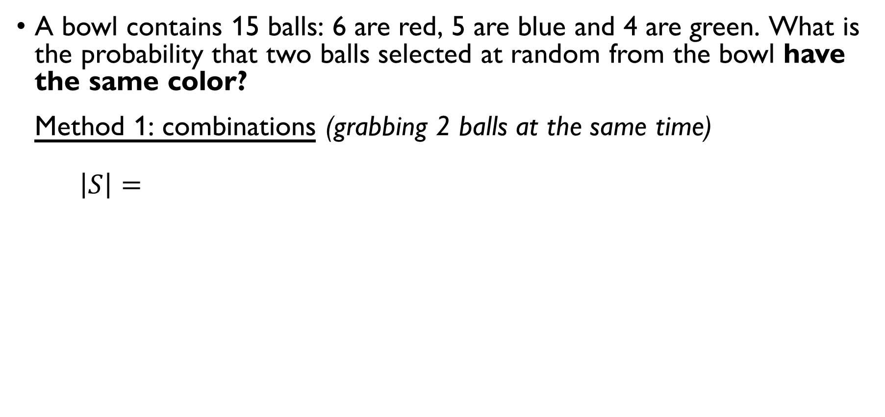
Balls from a bowl
A bowl contains 15 balls: 6 are red, 5 are blue and 4 are green. What is the probability that two balls selected at random from the bowl have the same color? Method 1: combinations (grabbing 2 balls at the same time)
$\left|S\right|=C\left(15, 2\right)=\frac{15!}{2!13!}=105$ ways to choose 2 balls out of 15
$$\left|E\right|=\left|E_{2 red}\right|+\left|E_{2 blue}\right|+\left|E_{2 green}\right|=$$ $=C\left(6, 2\right)+C\left(5, 2\right)+C\left(4, 2\right)=15+10+6=31$ ways to choose 2 same-color balls
$$P\left(E\right)=31/105$$

Slide 14
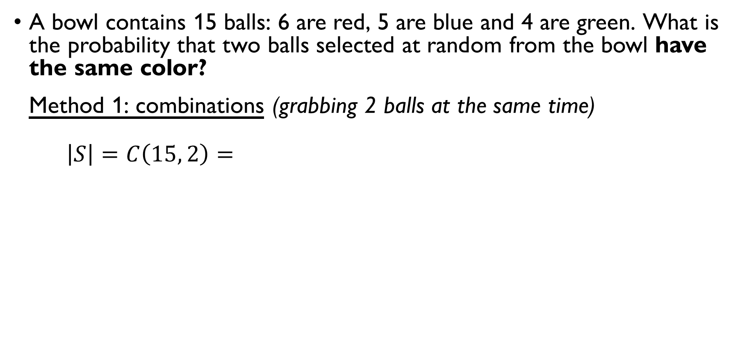
Balls from a bowl
A bowl contains 15 balls: 6 are red, 5 are blue and 4 are green. What is the probability that two balls selected at random from the bowl have the same color? Method 1: combinations (grabbing 2 balls at the same time)
$\left|S\right|=C\left(15, 2\right)=\frac{15!}{2!13!}=105$ ways to choose 2 balls out of 15
$$\left|E\right|=\left|E_{2 red}\right|+\left|E_{2 blue}\right|+\left|E_{2 green}\right|=$$ $=C\left(6, 2\right)+C\left(5, 2\right)+C\left(4, 2\right)=15+10+6=31$ ways to choose 2 same-color balls
$$P\left(E\right)=31/105$$

Slide 15
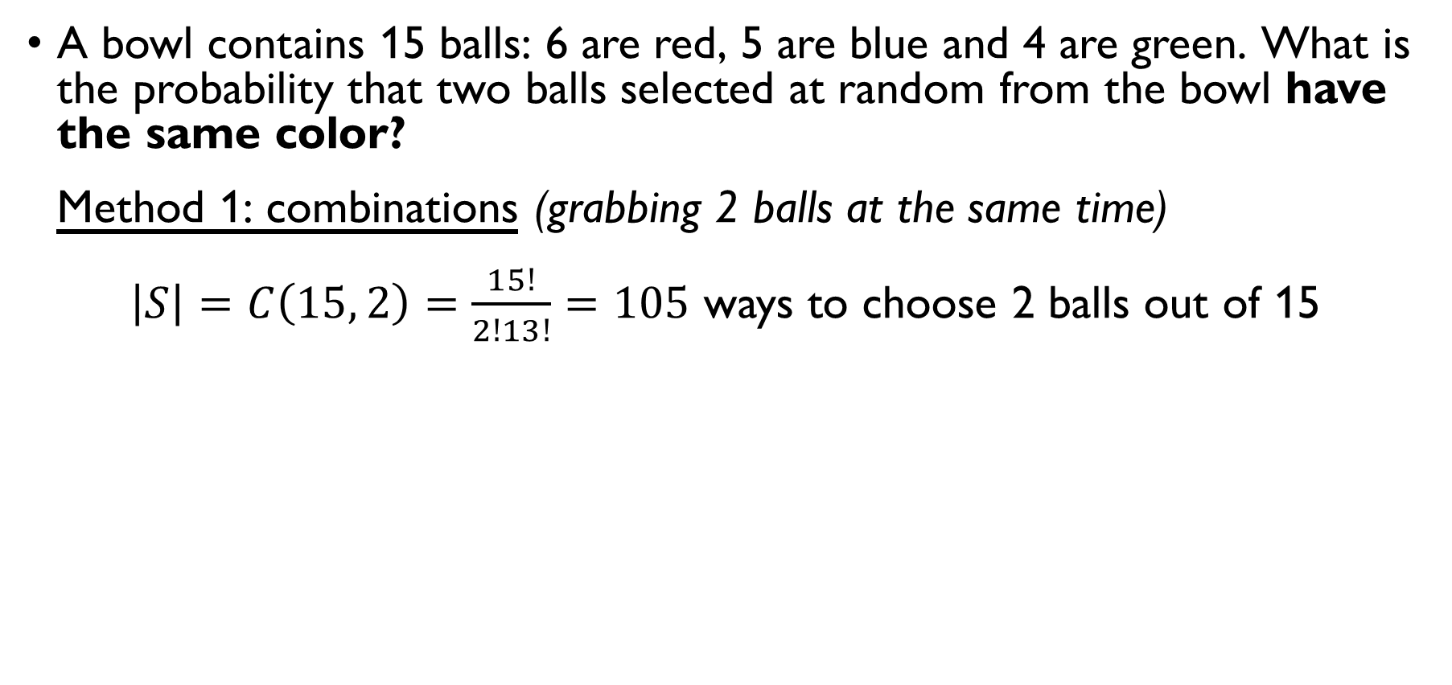
Balls from a bowl
A bowl contains 15 balls: 6 are red, 5 are blue and 4 are green. What is the probability that two balls selected at random from the bowl have the same color? Method 1: combinations (grabbing 2 balls at the same time)
$\left|S\right|=C\left(15, 2\right)=\frac{15!}{2!13!}=105$ ways to choose 2 balls out of 15
$$\left|E\right|=\left|E_{2 red}\right|+\left|E_{2 blue}\right|+\left|E_{2 green}\right|=$$ $=C\left(6, 2\right)+C\left(5, 2\right)+C\left(4, 2\right)=15+10+6=31$ ways to choose 2 same-color balls
$$P\left(E\right)=31/105$$

Slide 16
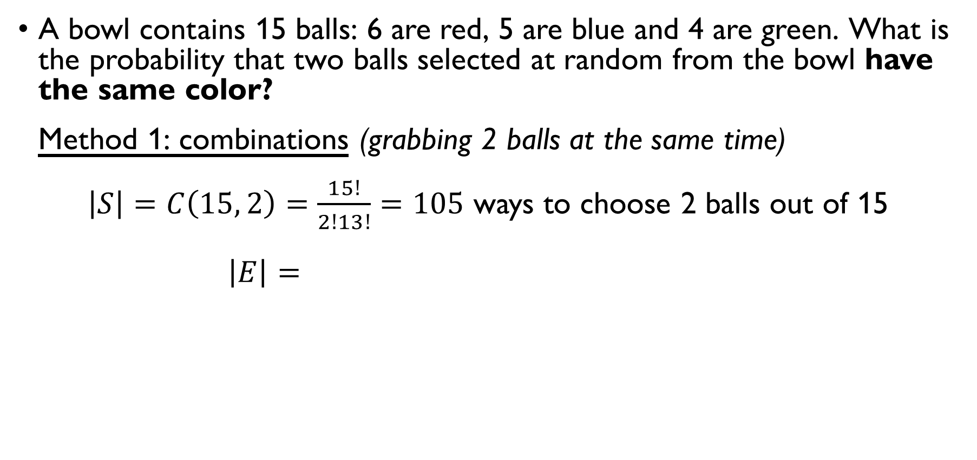
Balls from a bowl
A bowl contains 15 balls: 6 are red, 5 are blue and 4 are green. What is the probability that two balls selected at random from the bowl have the same color? Method 1: combinations (grabbing 2 balls at the same time)
$\left|S\right|=C\left(15, 2\right)=\frac{15!}{2!13!}=105$ ways to choose 2 balls out of 15
$$\left|E\right|=\left|E_{2 red}\right|+\left|E_{2 blue}\right|+\left|E_{2 green}\right|=$$ $=C\left(6, 2\right)+C\left(5, 2\right)+C\left(4, 2\right)=15+10+6=31$ ways to choose 2 same-color balls
$$P\left(E\right)=31/105$$

Slide 17
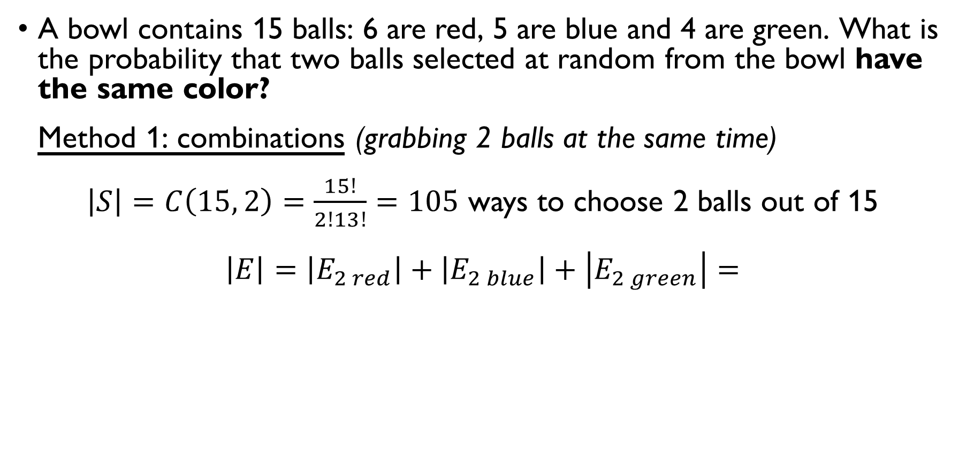
Balls from a bowl
A bowl contains 15 balls: 6 are red, 5 are blue and 4 are green. What is the probability that two balls selected at random from the bowl have the same color? Method 1: combinations (grabbing 2 balls at the same time)
$\left|S\right|=C\left(15, 2\right)=\frac{15!}{2!13!}=105$ ways to choose 2 balls out of 15
$$\left|E\right|=\left|E_{2 red}\right|+\left|E_{2 blue}\right|+\left|E_{2 green}\right|=$$ $=C\left(6, 2\right)+C\left(5, 2\right)+C\left(4, 2\right)=15+10+6=31$ ways to choose 2 same-color balls
$$P\left(E\right)=31/105$$

Slide 18
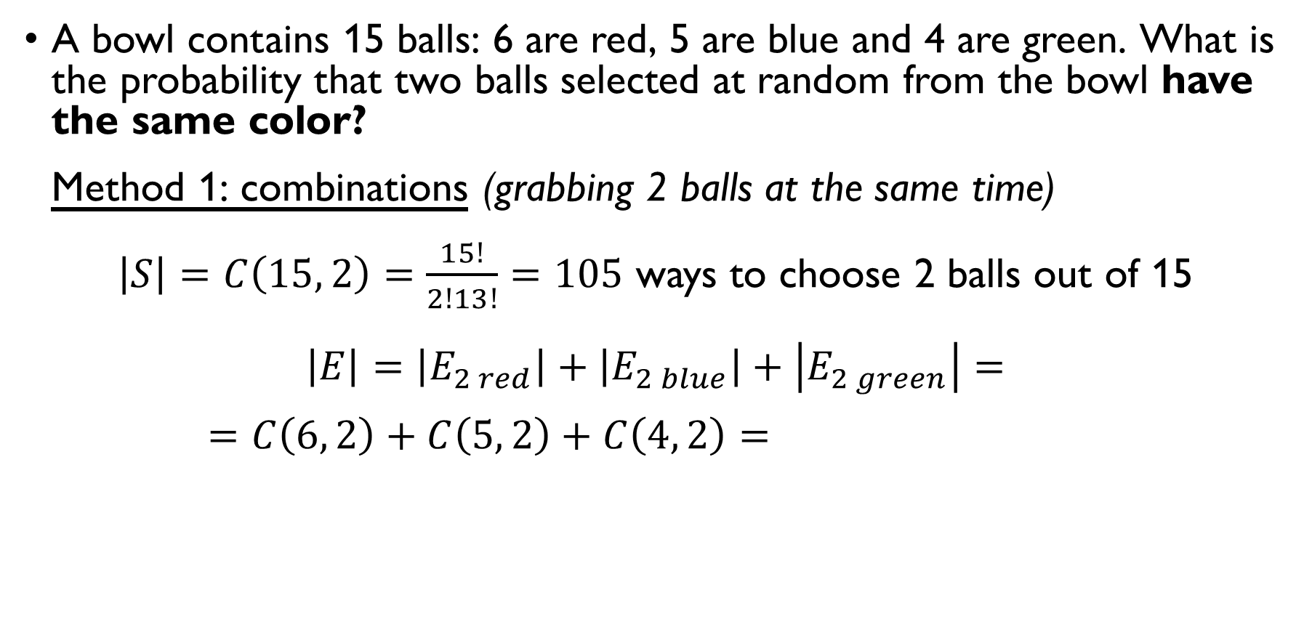
Balls from a bowl
A bowl contains 15 balls: 6 are red, 5 are blue and 4 are green. What is the probability that two balls selected at random from the bowl have the same color? Method 1: combinations (grabbing 2 balls at the same time)
$\left|S\right|=C\left(15, 2\right)=\frac{15!}{2!13!}=105$ ways to choose 2 balls out of 15
$$\left|E\right|=\left|E_{2 red}\right|+\left|E_{2 blue}\right|+\left|E_{2 green}\right|=$$ $=C\left(6, 2\right)+C\left(5, 2\right)+C\left(4, 2\right)=15+10+6=31$ ways to choose 2 same-color balls
$$P\left(E\right)=31/105$$

Slide 19
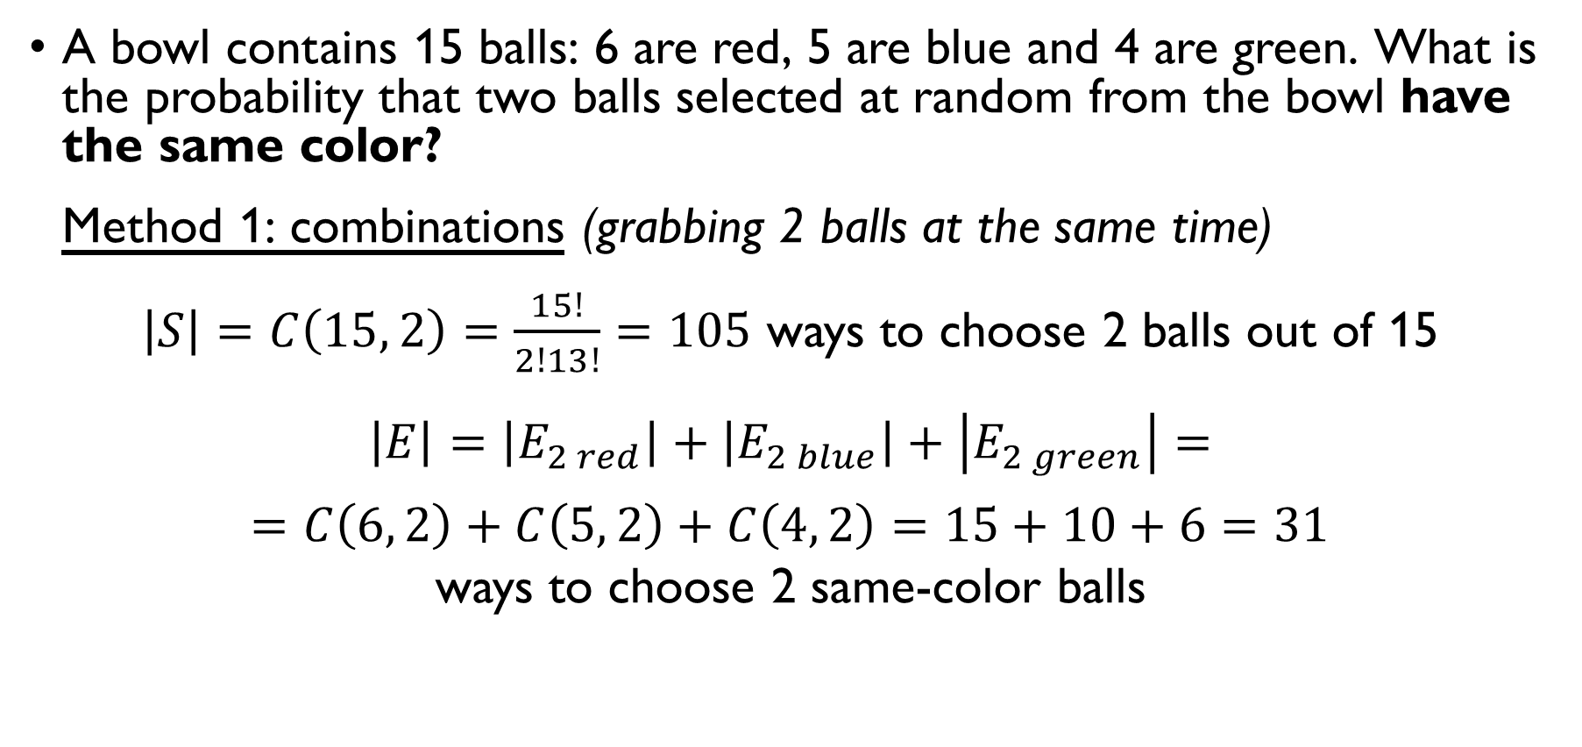
Balls from a bowl
A bowl contains 15 balls: 6 are red, 5 are blue and 4 are green. What is the probability that two balls selected at random from the bowl have the same color? Method 1: combinations (grabbing 2 balls at the same time)
$\left|S\right|=C\left(15, 2\right)=\frac{15!}{2!13!}=105$ ways to choose 2 balls out of 15
$$\left|E\right|=\left|E_{2 red}\right|+\left|E_{2 blue}\right|+\left|E_{2 green}\right|=$$ $=C\left(6, 2\right)+C\left(5, 2\right)+C\left(4, 2\right)=15+10+6=31$ ways to choose 2 same-color balls
$$P\left(E\right)=31/105$$

Slide 20
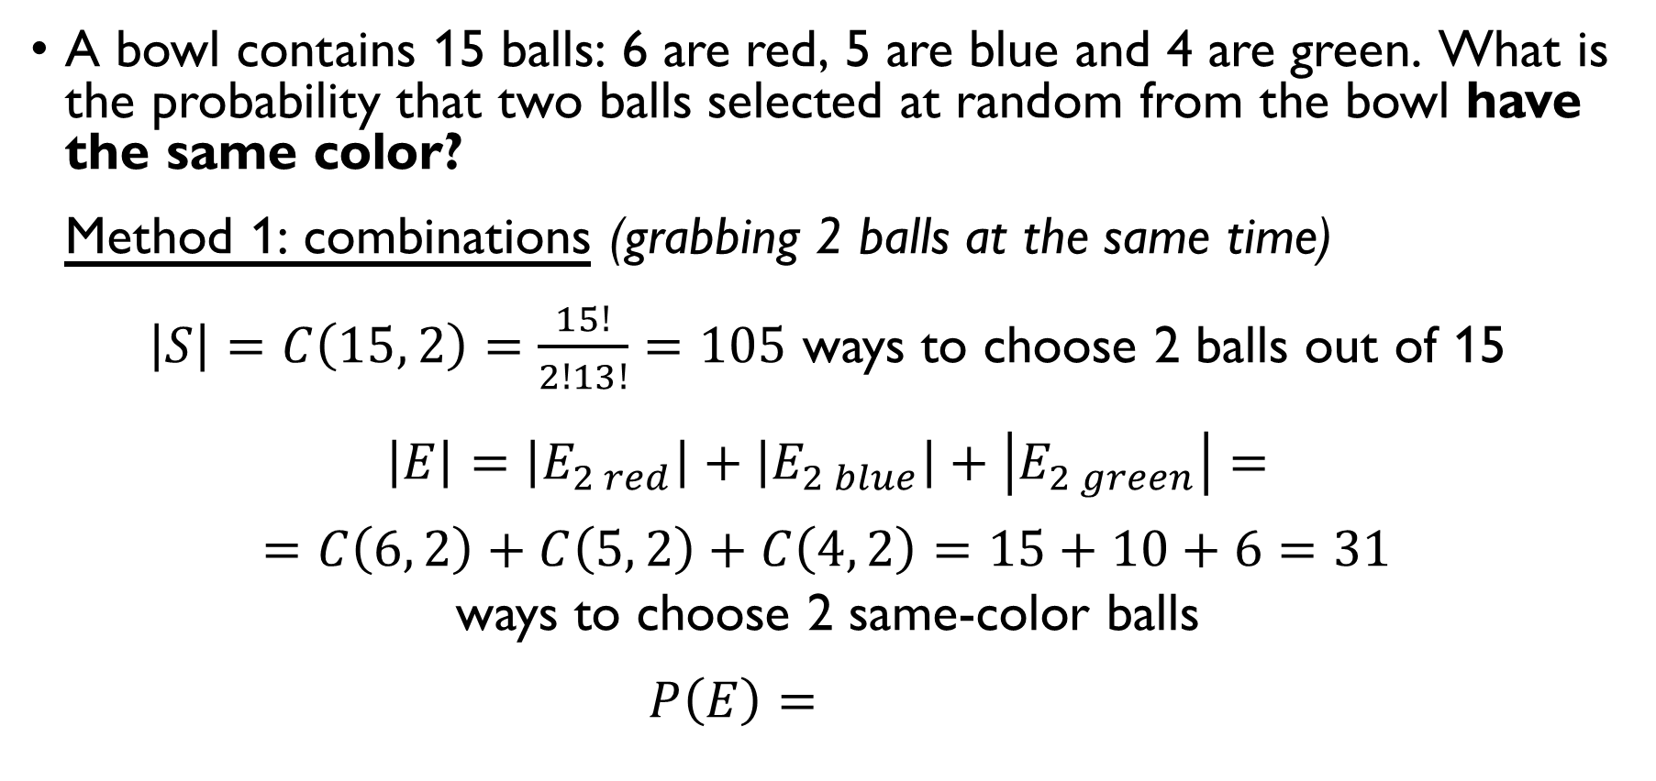
Balls from a bowl
A bowl contains 15 balls: 6 are red, 5 are blue and 4 are green. What is the probability that two balls selected at random from the bowl have the same color? Method 1: combinations (grabbing 2 balls at the same time)
$\left|S\right|=C\left(15, 2\right)=\frac{15!}{2!13!}=105$ ways to choose 2 balls out of 15
$$\left|E\right|=\left|E_{2 red}\right|+\left|E_{2 blue}\right|+\left|E_{2 green}\right|=$$ $=C\left(6, 2\right)+C\left(5, 2\right)+C\left(4, 2\right)=15+10+6=31$ ways to choose 2 same-color balls
$$P\left(E\right)=31/105$$

Slide 21
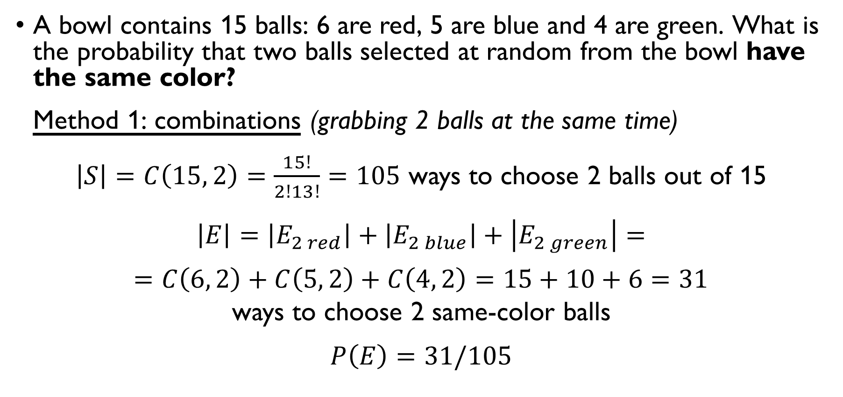
Balls from a bowl
A bowl contains 15 balls: 6 are red, 5 are blue and 4 are green. What is the probability that two balls selected at random from the bowl have the same color? Method 1: combinations (grabbing 2 balls at the same time)
$\left|S\right|=C\left(15, 2\right)=\frac{15!}{2!13!}=105$ ways to choose 2 balls out of 15
$$\left|E\right|=\left|E_{2 red}\right|+\left|E_{2 blue}\right|+\left|E_{2 green}\right|=$$ $=C\left(6, 2\right)+C\left(5, 2\right)+C\left(4, 2\right)=15+10+6=31$ ways to choose 2 same-color balls
$$P\left(E\right)=31/105$$

Slide 22
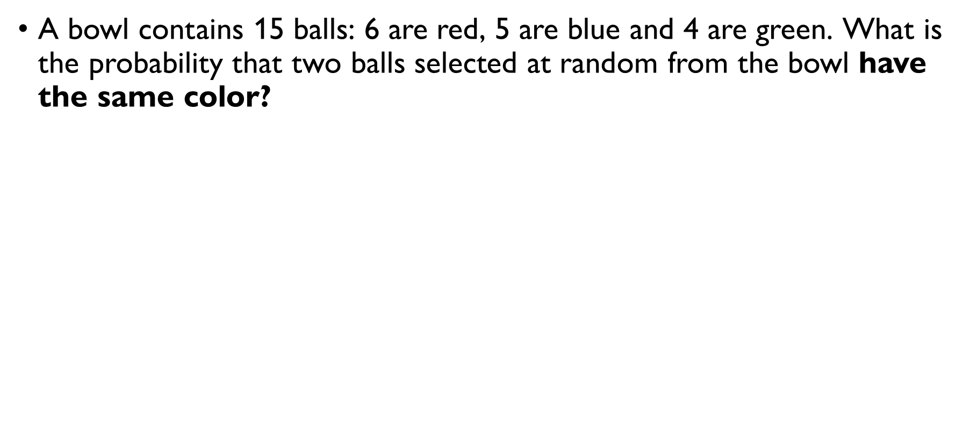
Balls from a bowl
A bowl contains 15 balls: 6 are red, 5 are blue and 4 are green. What is the probability that two balls selected at random from the bowl have the same color? Method 2: 2-permutations (grabbing 2 balls one-by-one)
$\left|S\right|=15⋅14=210$ ways to pick 2 balls out of 15 one-by-one
$$\left|E\right|=\left|E_{red, red}\right|+\left|E_{blue, blue}\right|+\left|E_{green, green}\right|=$$
$=6⋅5+5⋅4+4⋅3=30+20+12=62$ ways to pick two same-color balls one by one
$$P\left(E\right)=62/210=31/105$$

Slide 23
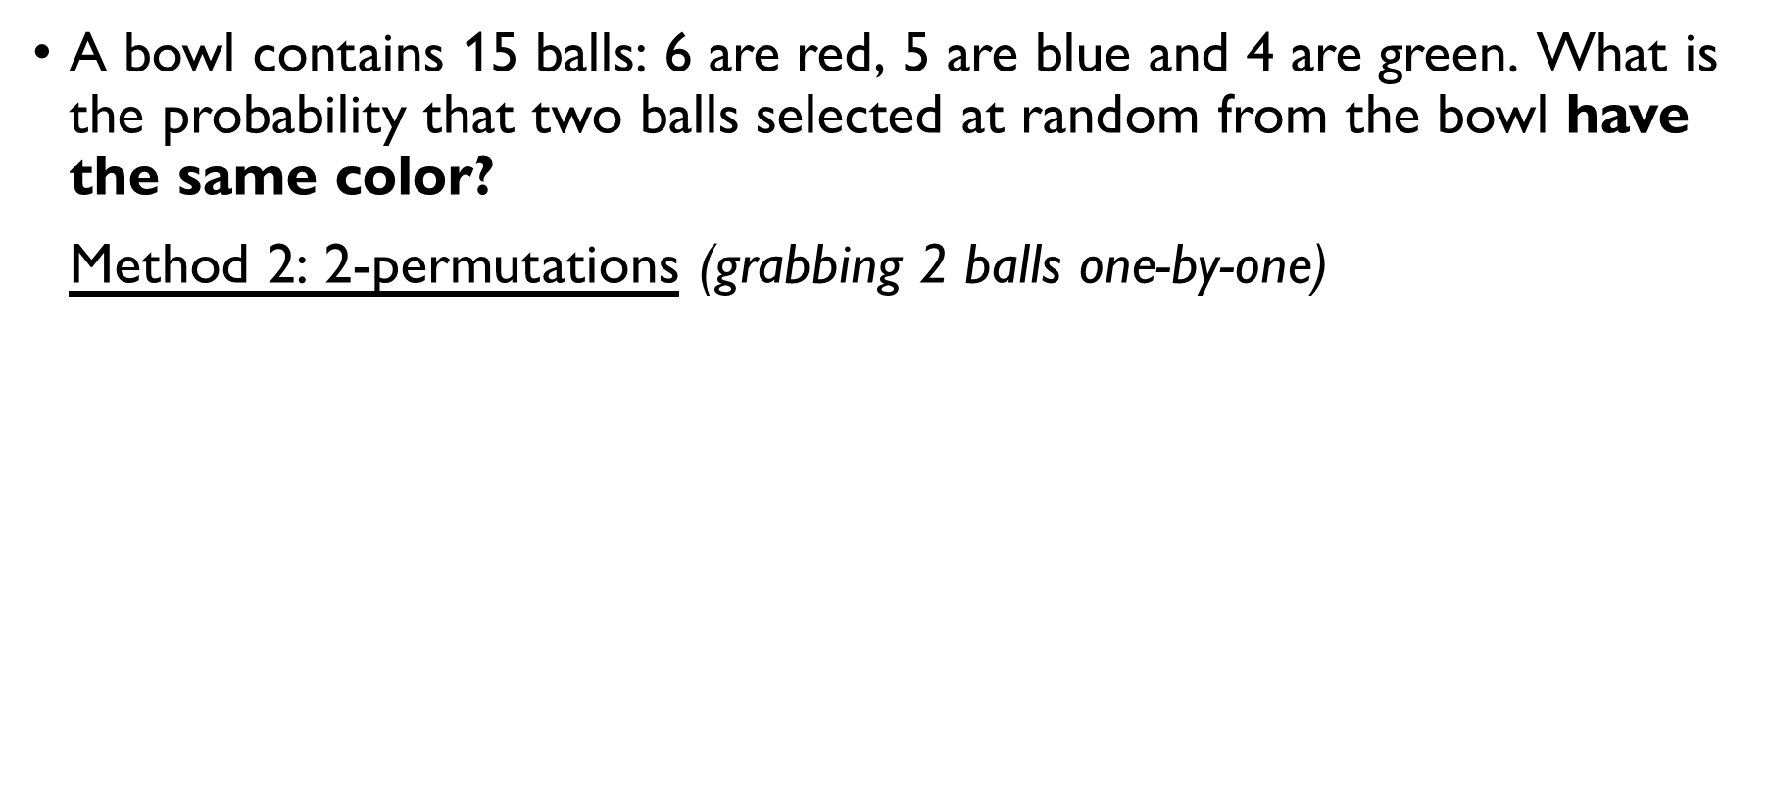
Balls from a bowl
A bowl contains 15 balls: 6 are red, 5 are blue and 4 are green. What is the probability that two balls selected at random from the bowl have the same color? Method 2: 2-permutations (grabbing 2 balls one-by-one)
$\left|S\right|=15⋅14=210$ ways to pick 2 balls out of 15 one-by-one
$$\left|E\right|=\left|E_{red, red}\right|+\left|E_{blue, blue}\right|+\left|E_{green, green}\right|=$$
$=6⋅5+5⋅4+4⋅3=30+20+12=62$ ways to pick two same-color balls one by one
$$P\left(E\right)=62/210=31/105$$

Slide 24
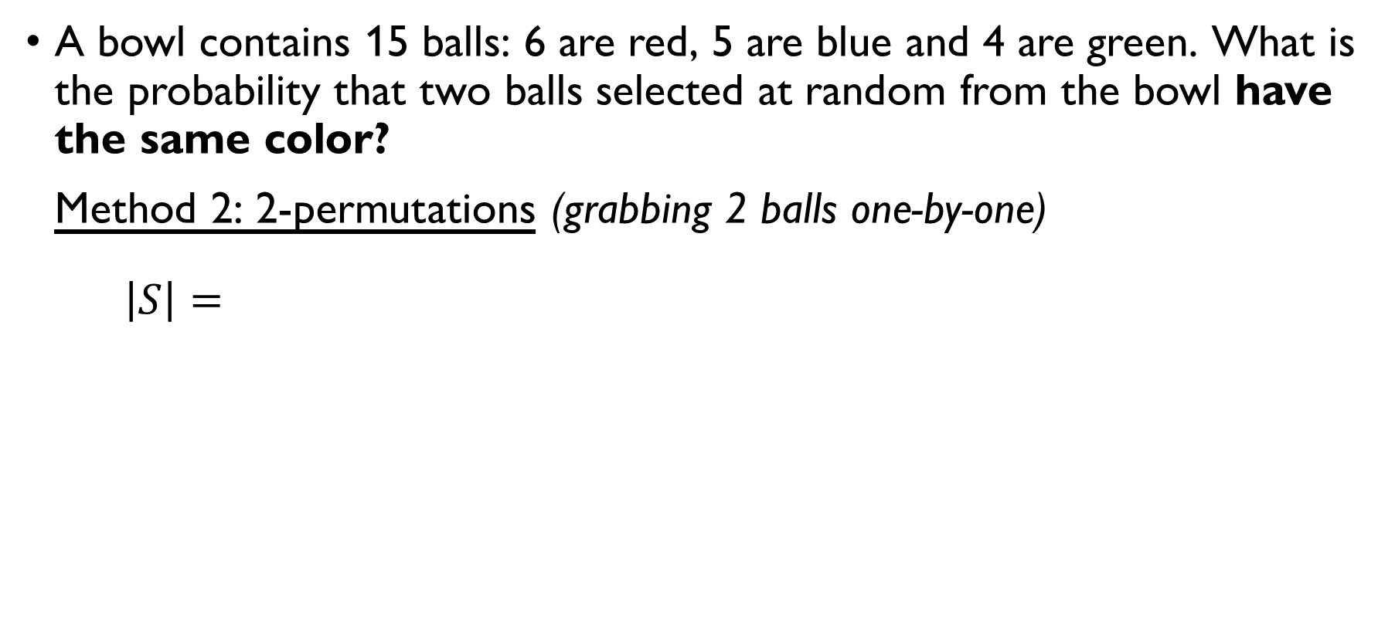
Balls from a bowl
A bowl contains 15 balls: 6 are red, 5 are blue and 4 are green. What is the probability that two balls selected at random from the bowl have the same color? Method 2: 2-permutations (grabbing 2 balls one-by-one)
$\left|S\right|=15⋅14=210$ ways to pick 2 balls out of 15 one-by-one
$$\left|E\right|=\left|E_{red, red}\right|+\left|E_{blue, blue}\right|+\left|E_{green, green}\right|=$$
$=6⋅5+5⋅4+4⋅3=30+20+12=62$ ways to pick two same-color balls one by one
$$P\left(E\right)=62/210=31/105$$

Slide 25
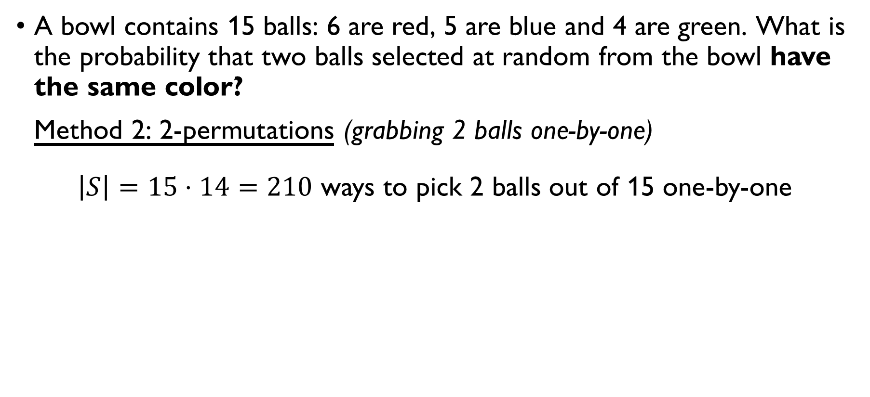
Balls from a bowl
A bowl contains 15 balls: 6 are red, 5 are blue and 4 are green. What is the probability that two balls selected at random from the bowl have the same color? Method 2: 2-permutations (grabbing 2 balls one-by-one)
$\left|S\right|=15⋅14=210$ ways to pick 2 balls out of 15 one-by-one
$$\left|E\right|=\left|E_{red, red}\right|+\left|E_{blue, blue}\right|+\left|E_{green, green}\right|=$$
$=6⋅5+5⋅4+4⋅3=30+20+12=62$ ways to pick two same-color balls one by one
$$P\left(E\right)=62/210=31/105$$

Slide 26
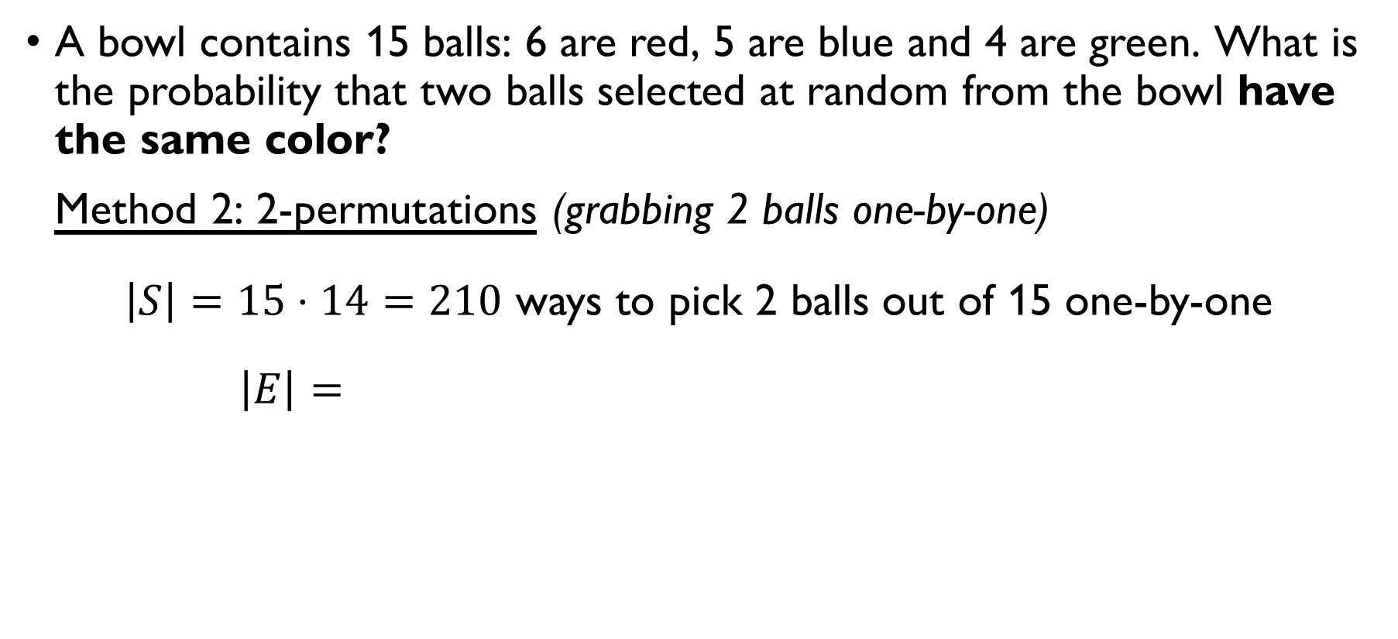
Balls from a bowl
A bowl contains 15 balls: 6 are red, 5 are blue and 4 are green. What is the probability that two balls selected at random from the bowl have the same color? Method 2: 2-permutations (grabbing 2 balls one-by-one)
$\left|S\right|=15⋅14=210$ ways to pick 2 balls out of 15 one-by-one
$$\left|E\right|=\left|E_{red, red}\right|+\left|E_{blue, blue}\right|+\left|E_{green, green}\right|=$$
$=6⋅5+5⋅4+4⋅3=30+20+12=62$ ways to pick two same-color balls one by one
$$P\left(E\right)=62/210=31/105$$

Slide 27
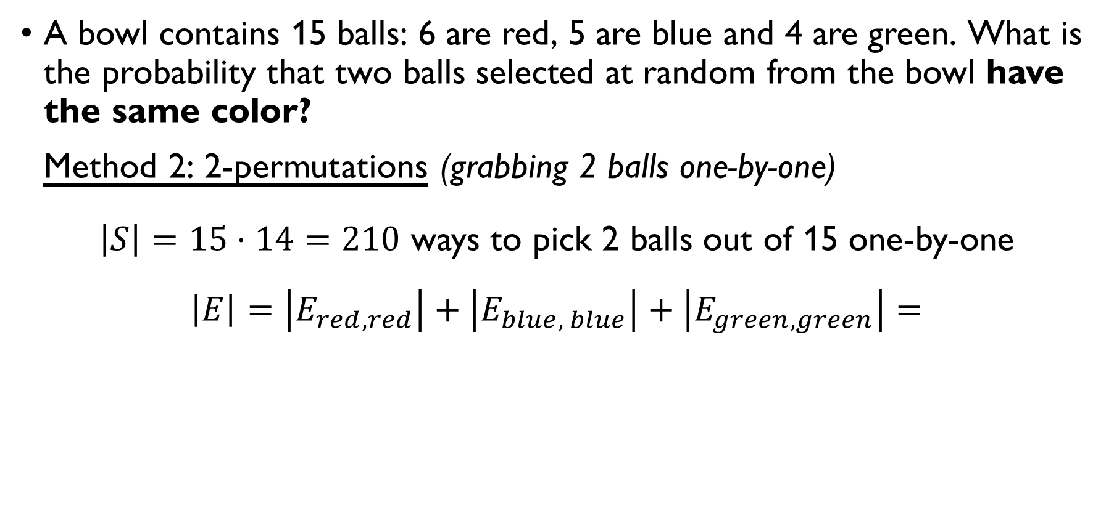
Balls from a bowl
A bowl contains 15 balls: 6 are red, 5 are blue and 4 are green. What is the probability that two balls selected at random from the bowl have the same color? Method 2: 2-permutations (grabbing 2 balls one-by-one)
$\left|S\right|=15⋅14=210$ ways to pick 2 balls out of 15 one-by-one
$$\left|E\right|=\left|E_{red, red}\right|+\left|E_{blue, blue}\right|+\left|E_{green, green}\right|=$$
$=6⋅5+5⋅4+4⋅3=30+20+12=62$ ways to pick two same-color balls one by one
$$P\left(E\right)=62/210=31/105$$

Slide 28
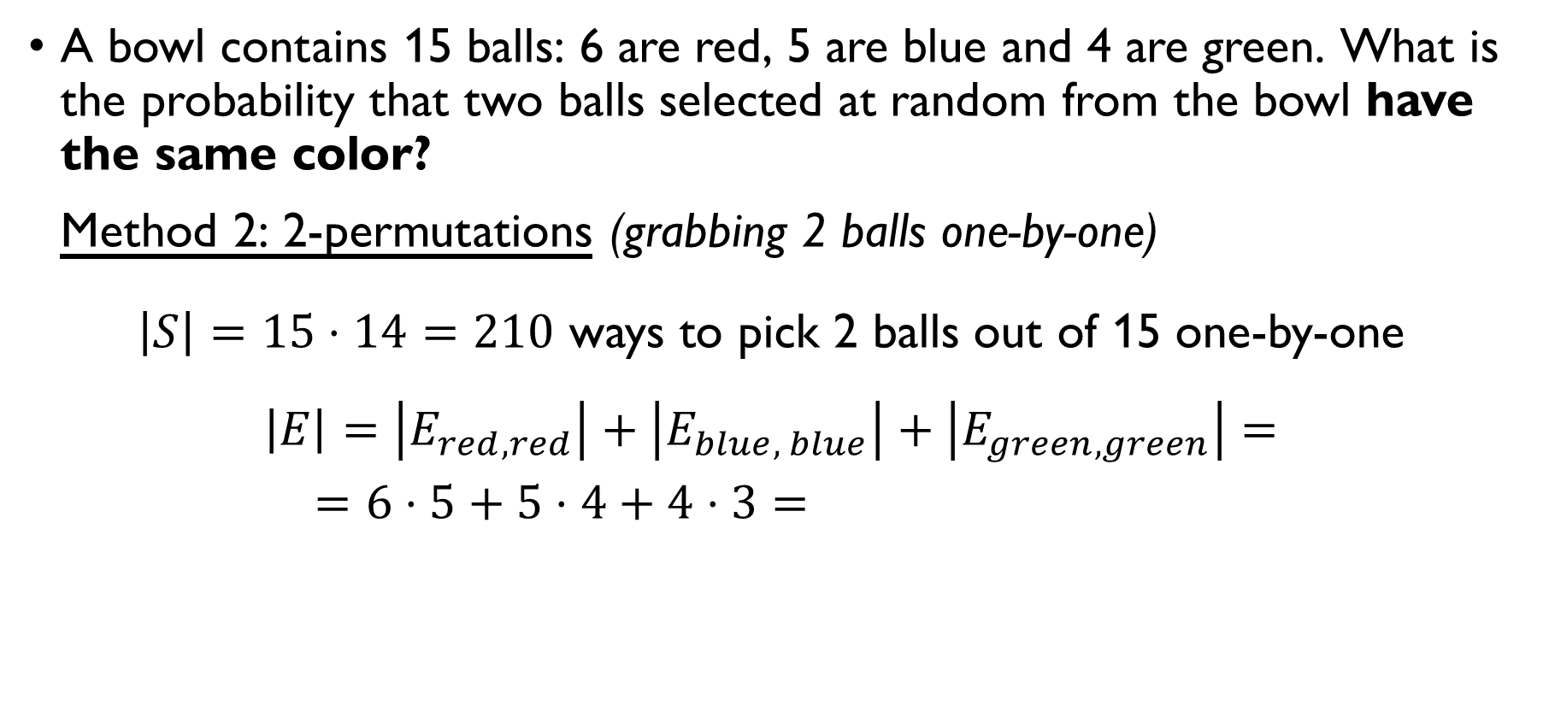
Balls from a bowl
A bowl contains 15 balls: 6 are red, 5 are blue and 4 are green. What is the probability that two balls selected at random from the bowl have the same color? Method 2: 2-permutations (grabbing 2 balls one-by-one)
$\left|S\right|=15⋅14=210$ ways to pick 2 balls out of 15 one-by-one
$$\left|E\right|=\left|E_{red, red}\right|+\left|E_{blue, blue}\right|+\left|E_{green, green}\right|=$$
$=6⋅5+5⋅4+4⋅3=30+20+12=62$ ways to pick two same-color balls one by one
$$P\left(E\right)=62/210=31/105$$

Slide 29
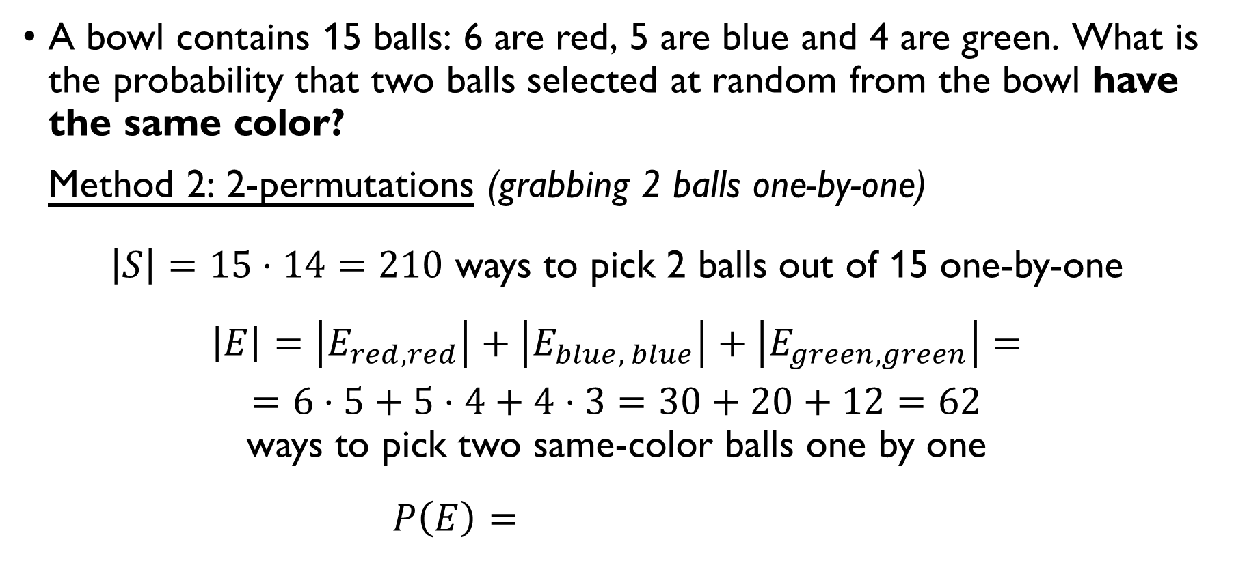
Balls from a bowl
A bowl contains 15 balls: 6 are red, 5 are blue and 4 are green. What is the probability that two balls selected at random from the bowl have the same color? Method 2: 2-permutations (grabbing 2 balls one-by-one)
$\left|S\right|=15⋅14=210$ ways to pick 2 balls out of 15 one-by-one
$$\left|E\right|=\left|E_{red, red}\right|+\left|E_{blue, blue}\right|+\left|E_{green, green}\right|=$$
$=6⋅5+5⋅4+4⋅3=30+20+12=62$ ways to pick two same-color balls one by one
$$P\left(E\right)=62/210=31/105$$

Slide 30
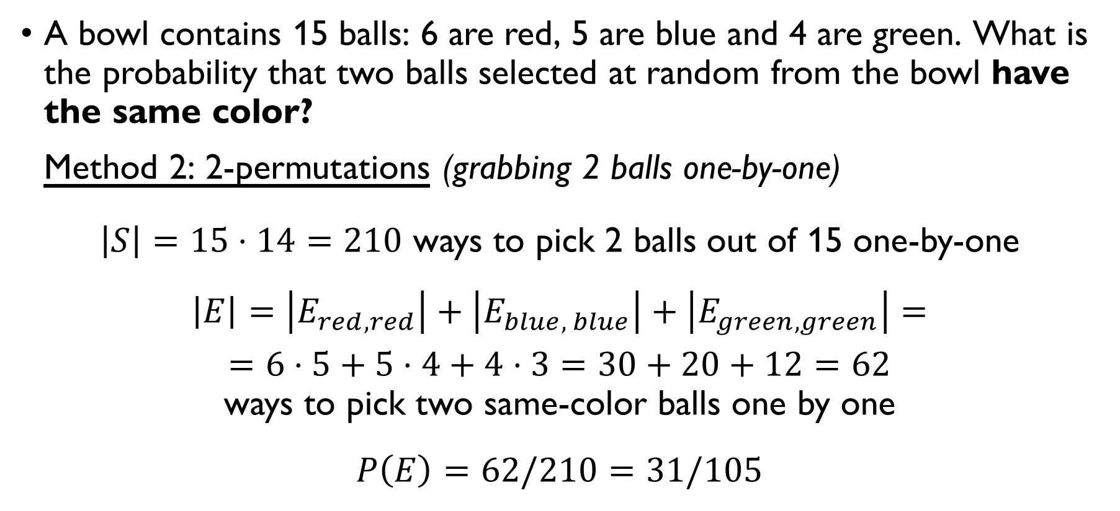
Balls from a bowl
A bowl contains 15 balls: 6 are red, 5 are blue and 4 are green. What is the probability that two balls selected at random from the bowl have the same color? Method 2: 2-permutations (grabbing 2 balls one-by-one)
$\left|S\right|=15⋅14=210$ ways to pick 2 balls out of 15 one-by-one
$$\left|E\right|=\left|E_{red, red}\right|+\left|E_{blue, blue}\right|+\left|E_{green, green}\right|=$$
$=6⋅5+5⋅4+4⋅3=30+20+12=62$ ways to pick two same-color balls one by one
$$P\left(E\right)=62/210=31/105$$

Slide 31
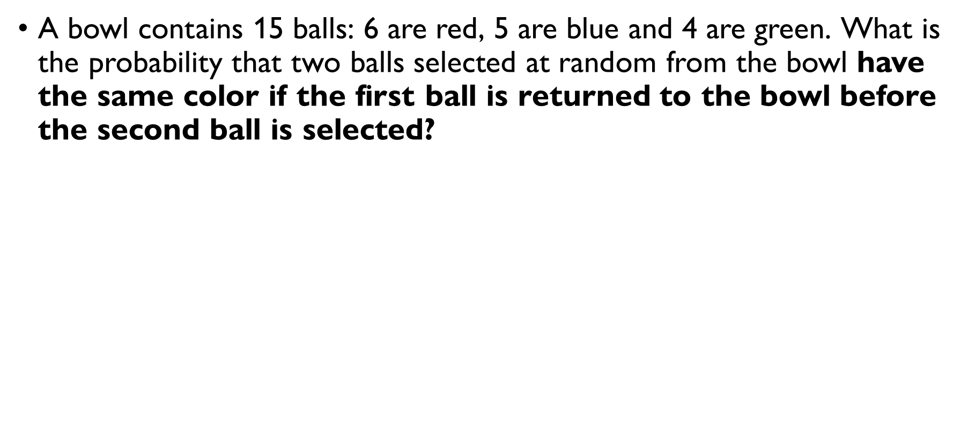
Balls from a bowl
A bowl contains 15 balls: 6 are red, 5 are blue and 4 are green. What is the probability that two balls selected at random from the bowl have the same color if the first ball is returned to the bowl before the second ball is selected? Grabbing 2 balls ne-by-one (with replacement): $\left|S\right|=15⋅15=225$
$$=\left|E_{red, red}\right|+\left|E_{blue, blue}\right|+\left|E_{green, green}\right|=$$
$$=6⋅6+5⋅5+4⋅4=36+25+16=\text{77} \\ \text{ways} \text{to} \text{pick} \text{two} \text{same}\text{-}\text{color} \text{balls} \text{one} \text{by} \text{one}$$
$$P\left(E\right)=77/225$$

Slide 32
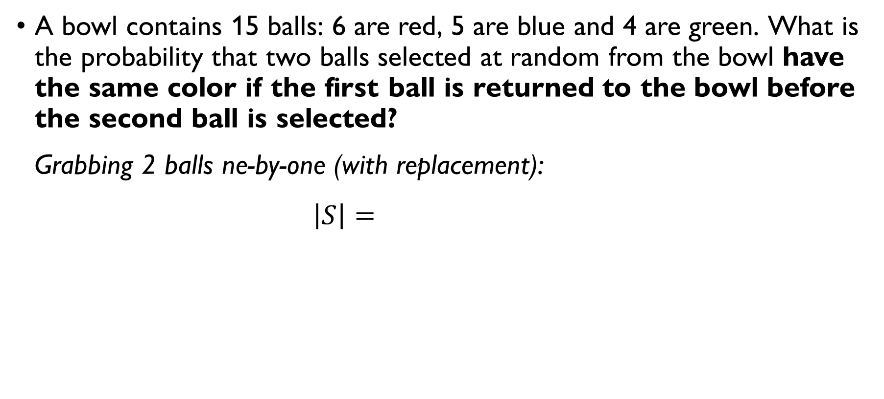
Balls from a bowl
A bowl contains 15 balls: 6 are red, 5 are blue and 4 are green. What is the probability that two balls selected at random from the bowl have the same color if the first ball is returned to the bowl before the second ball is selected? Grabbing 2 balls ne-by-one (with replacement): $\left|S\right|=15⋅15=225$
$$=\left|E_{red, red}\right|+\left|E_{blue, blue}\right|+\left|E_{green, green}\right|=$$
$$=6⋅6+5⋅5+4⋅4=36+25+16=\text{77} \\ \text{ways} \text{to} \text{pick} \text{two} \text{same}\text{-}\text{color} \text{balls} \text{one} \text{by} \text{one}$$
$$P\left(E\right)=77/225$$

Slide 33
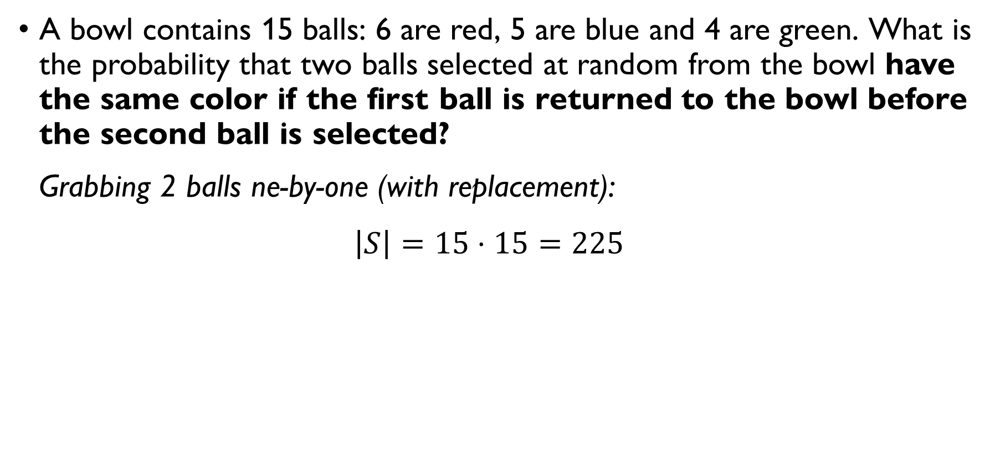
Balls from a bowl
A bowl contains 15 balls: 6 are red, 5 are blue and 4 are green. What is the probability that two balls selected at random from the bowl have the same color if the first ball is returned to the bowl before the second ball is selected? Grabbing 2 balls ne-by-one (with replacement): $\left|S\right|=15⋅15=225$
$$=\left|E_{red, red}\right|+\left|E_{blue, blue}\right|+\left|E_{green, green}\right|=$$
$$=6⋅6+5⋅5+4⋅4=36+25+16=\text{77} \\ \text{ways} \text{to} \text{pick} \text{two} \text{same}\text{-}\text{color} \text{balls} \text{one} \text{by} \text{one}$$
$$P\left(E\right)=77/225$$

Slide 34
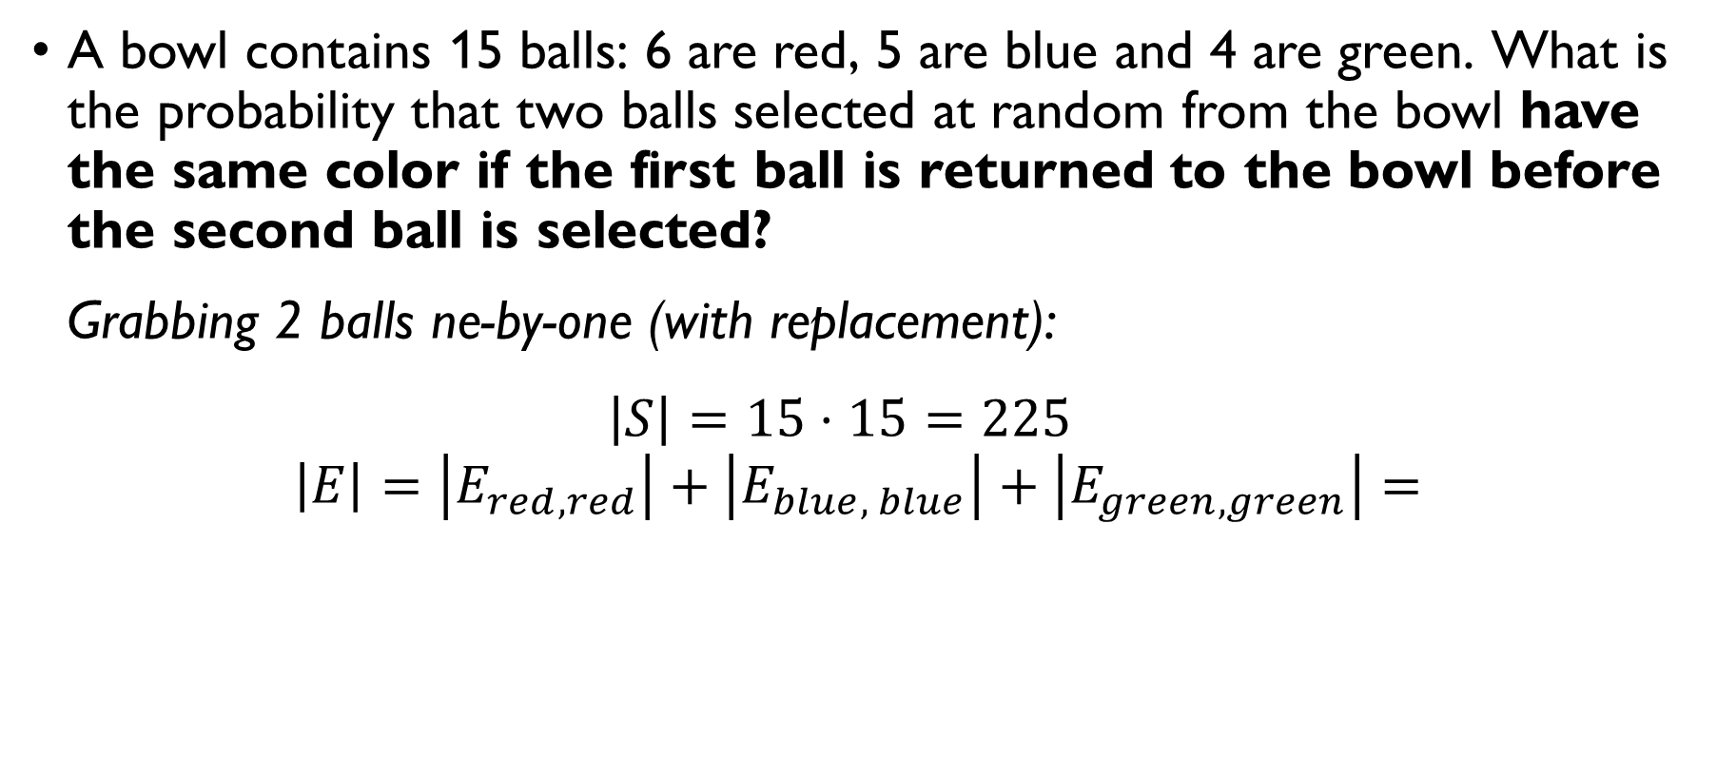
Balls from a bowl
A bowl contains 15 balls: 6 are red, 5 are blue and 4 are green. What is the probability that two balls selected at random from the bowl have the same color if the first ball is returned to the bowl before the second ball is selected? Grabbing 2 balls ne-by-one (with replacement): $\left|S\right|=15⋅15=225$
$$\left|E\right|=\left|E_{red, red}\right|+\left|E_{blue, blue}\right|+\left|E_{green, green}\right|=$$
$$=6⋅6+5⋅5+4⋅4=36+25+16=\text{77} \\ \text{ways} \text{to} \text{pick} \text{two} \text{same}\text{-}\text{color} \text{balls} \text{one} \text{by} \text{one}$$
$$P\left(E\right)=77/225$$

Slide 35
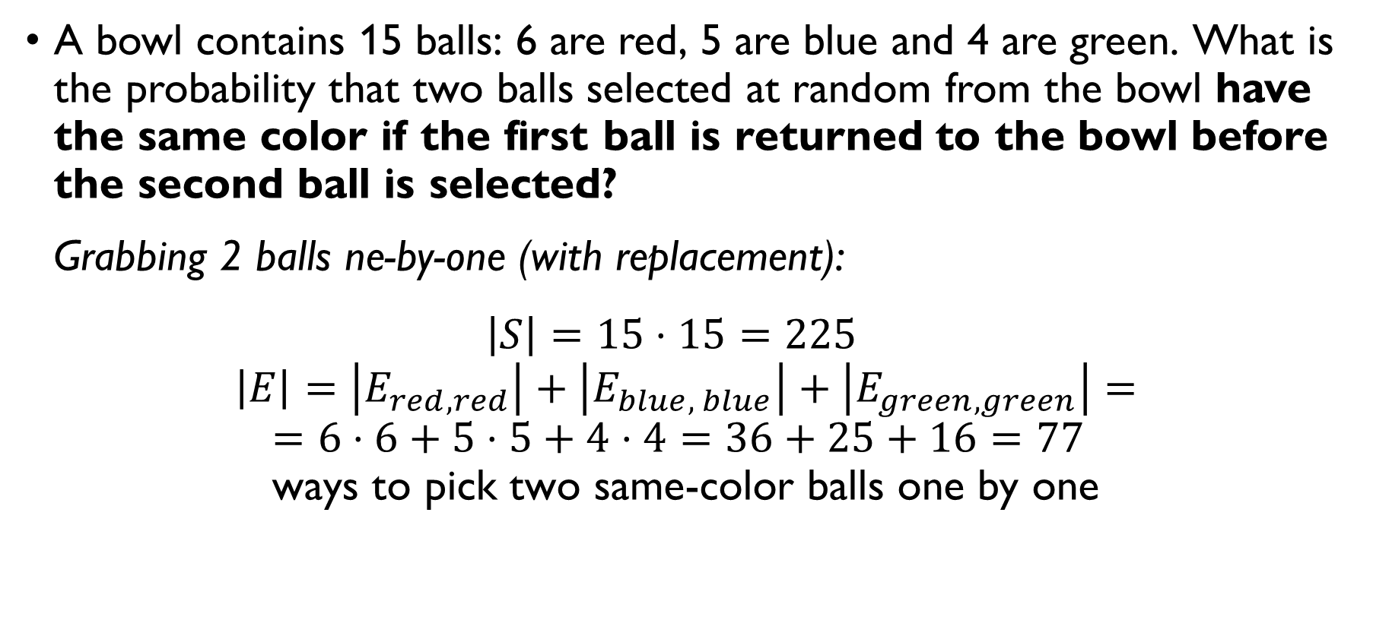
Balls from a bowl
A bowl contains 15 balls: 6 are red, 5 are blue and 4 are green. What is the probability that two balls selected at random from the bowl have the same color if the first ball is returned to the bowl before the second ball is selected? Grabbing 2 balls ne-by-one (with replacement): $\left|S\right|=15⋅15=225$
$$\left|E\right|=\left|E_{red, red}\right|+\left|E_{blue, blue}\right|+\left|E_{green, green}\right|=$$
$$=6⋅6+5⋅5+4⋅4=36+25+16=\text{77} \\ \text{ways} \text{to} \text{pick} \text{two} \text{same}\text{-}\text{color} \text{balls} \text{one} \text{by} \text{one}$$
$$P\left(E\right)=77/225$$

Slide 36
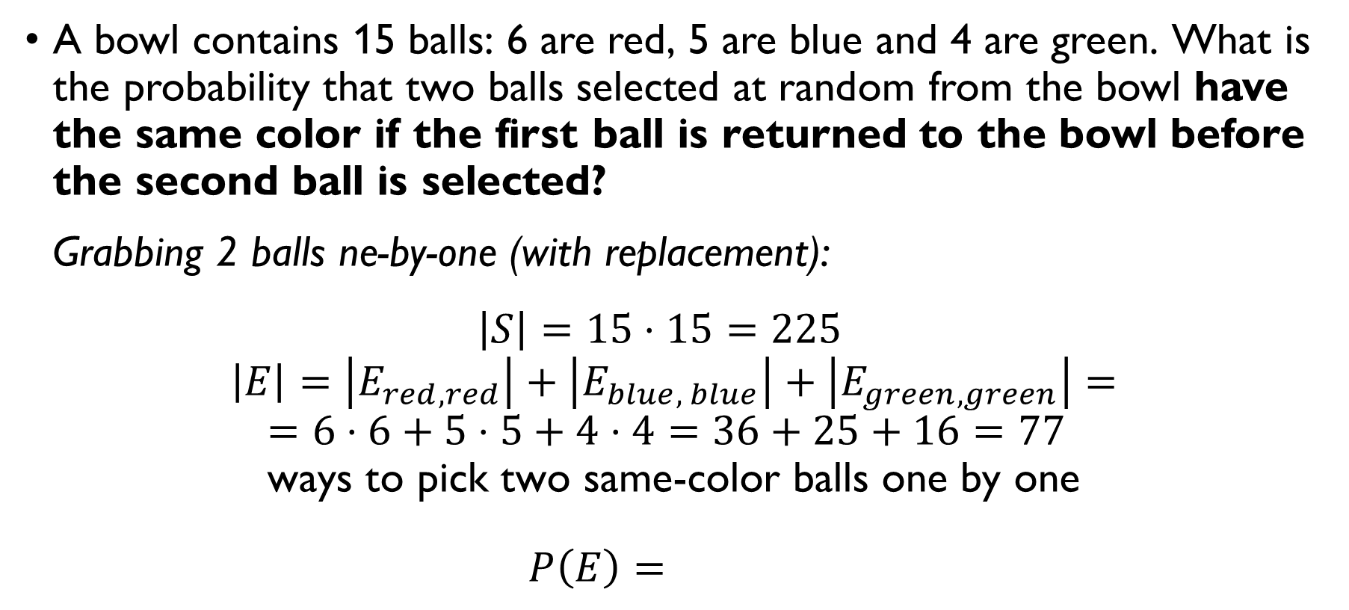
Balls from a bowl
A bowl contains 15 balls: 6 are red, 5 are blue and 4 are green. What is the probability that two balls selected at random from the bowl have the same color if the first ball is returned to the bowl before the second ball is selected? Grabbing 2 balls ne-by-one (with replacement): $\left|S\right|=15⋅15=225$
$$\left|E\right|=\left|E_{red, red}\right|+\left|E_{blue, blue}\right|+\left|E_{green, green}\right|=$$
$$=6⋅6+5⋅5+4⋅4=36+25+16=\text{77} \\ \text{ways} \text{to} \text{pick} \text{two} \text{same}\text{-}\text{color} \text{balls} \text{one} \text{by} \text{one}$$
$$P\left(E\right)=77/225$$

Slide 37
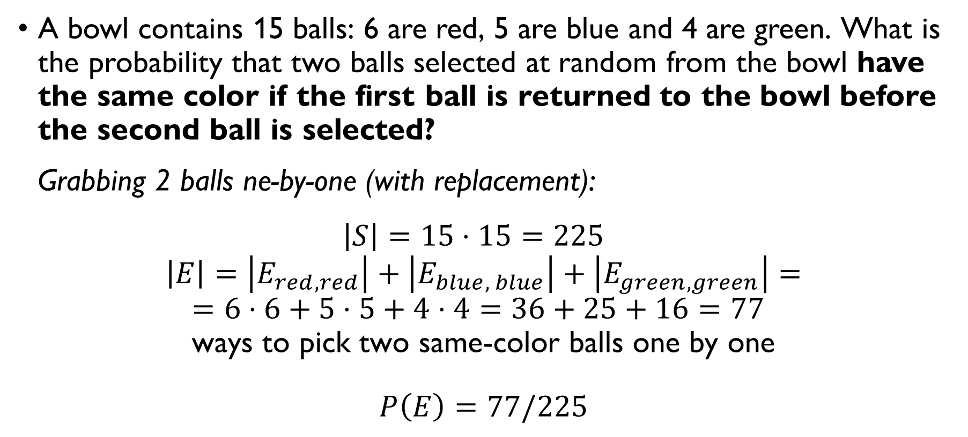
Balls from a bowl
A bowl contains 15 balls: 6 are red, 5 are blue and 4 are green. What is the probability that two balls selected at random from the bowl have the same color if the first ball is returned to the bowl before the second ball is selected? Grabbing 2 balls ne-by-one (with replacement): $\left|S\right|=15⋅15=225$
$$\left|E\right|=\left|E_{red, red}\right|+\left|E_{blue, blue}\right|+\left|E_{green, green}\right|=$$
$$=6⋅6+5⋅5+4⋅4=36+25+16=\text{77} \\ \text{ways} \text{to} \text{pick} \text{two} \text{same}\text{-}\text{color} \text{balls} \text{one} \text{by} \text{one}$$
$$P\left(E\right)=77/225$$

Slide 38
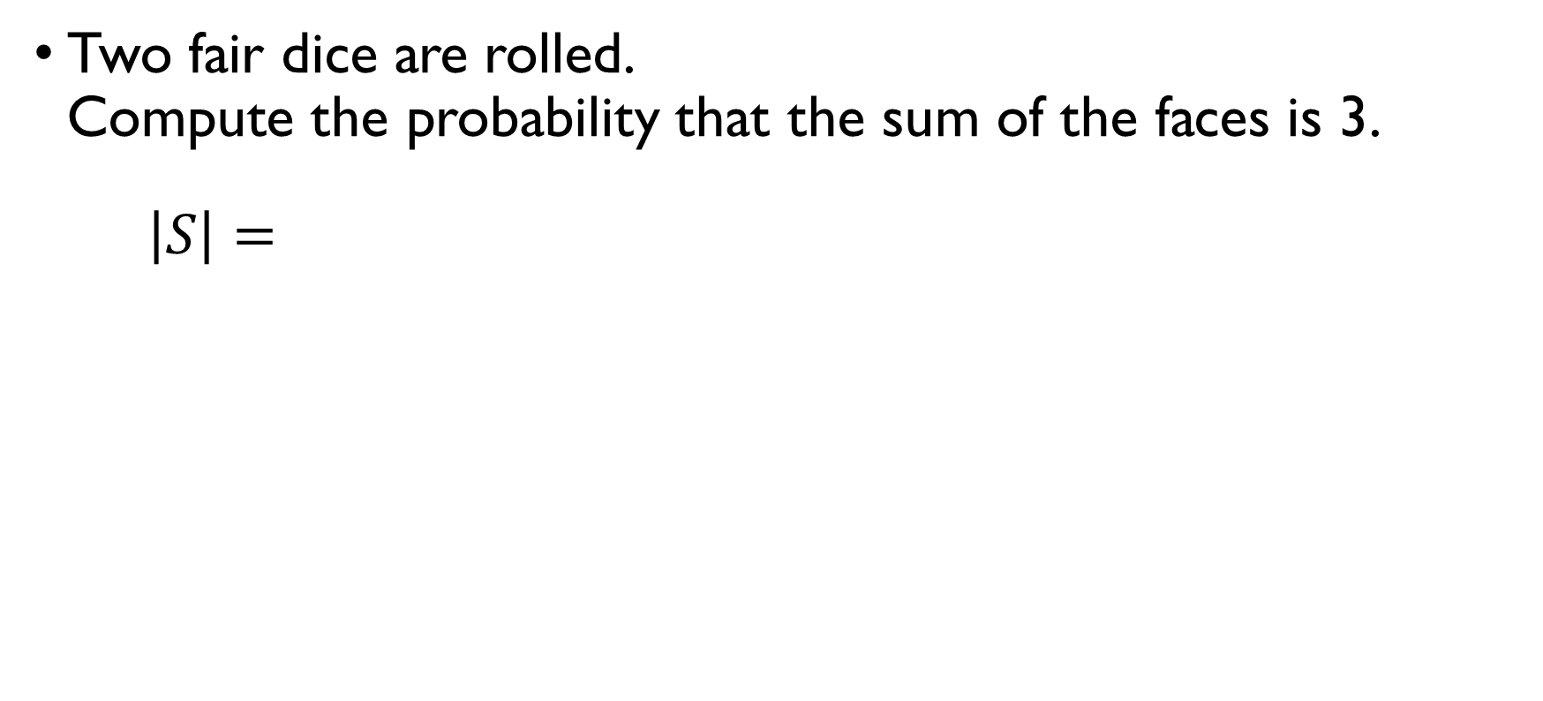
Rolling dice
Two fair dice are rolled. Compute the probability that the sum of the faces is 3.
$\left|S\right|=6⋅6=36$ different pairs of values are possible
$\left|E\right|=\left|\left\{\left(1, 2\right), \left(2, 1\right)\right\}\right|=2$ of the combinations give 3 in total
$$P\left(E\right)=\frac{2}{36}=\frac{1}{18}≈0.03$$

Slide 39
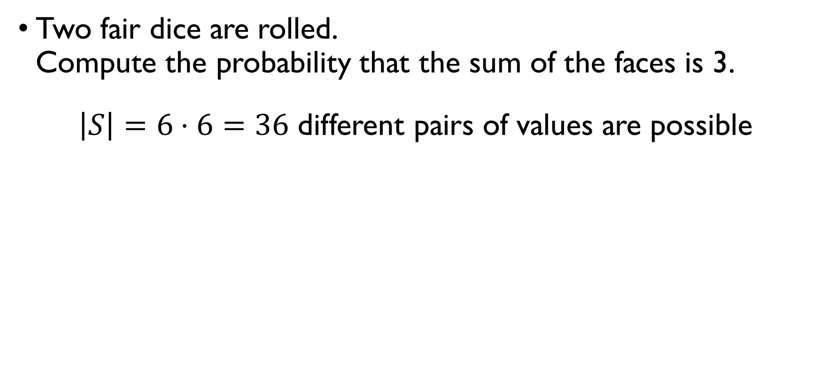
Rolling dice
Two fair dice are rolled. Compute the probability that the sum of the faces is 3.
$\left|S\right|=6⋅6=36$ different pairs of values are possible
$\left|E\right|=\left|\left\{\left(1, 2\right), \left(2, 1\right)\right\}\right|=2$ of the combinations give 3 in total
$$P\left(E\right)=\frac{2}{36}=\frac{1}{18}≈0.03$$

Slide 40
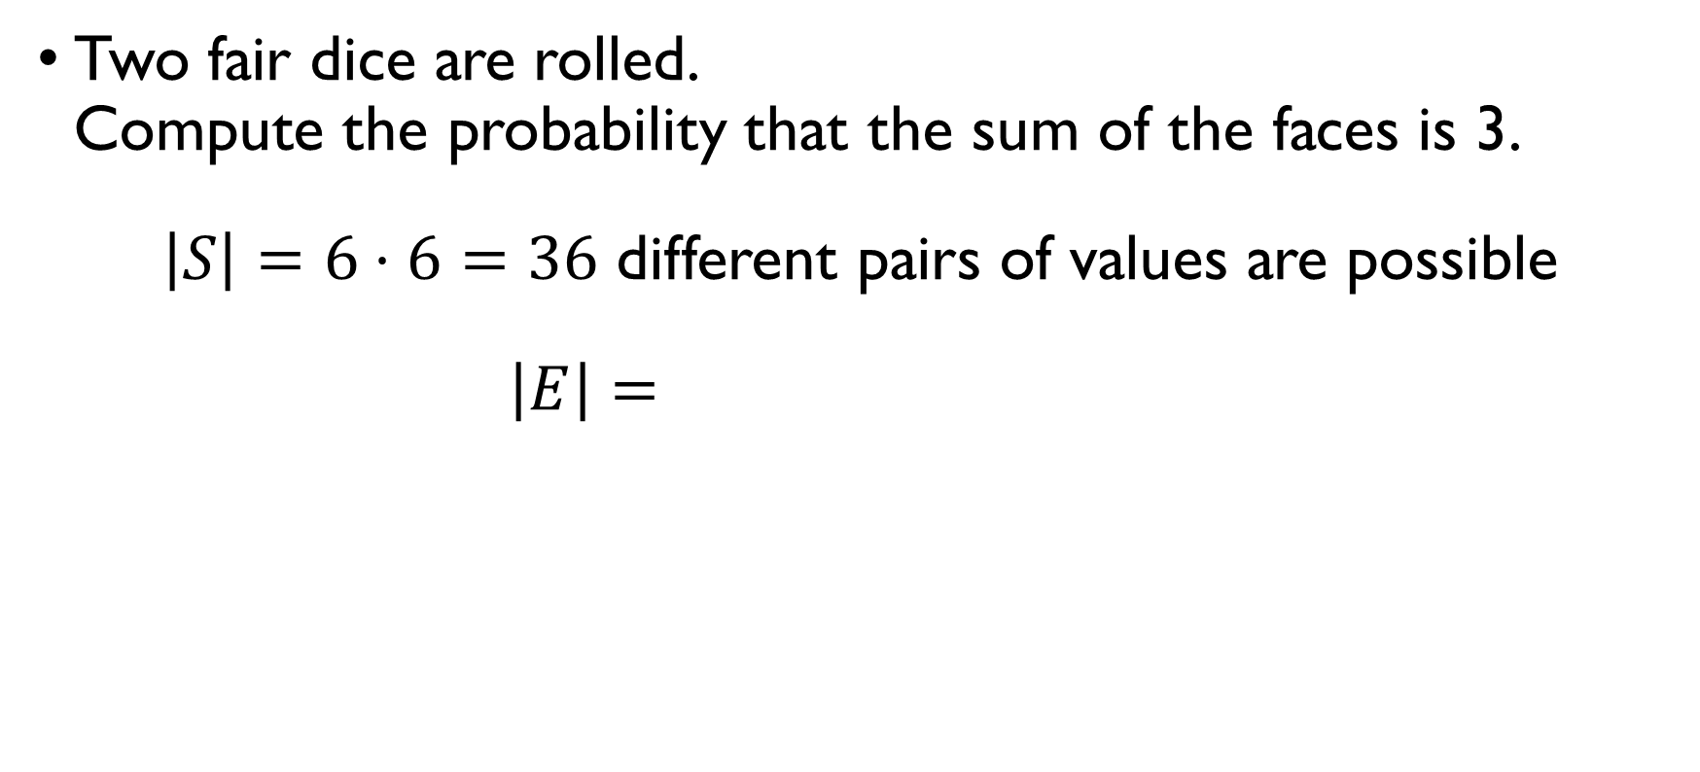
Rolling dice
Two fair dice are rolled. Compute the probability that the sum of the faces is 3.
$\left|S\right|=6⋅6=36$ different pairs of values are possible
$\left|E\right|=\left|\left\{\left(1, 2\right), \left(2, 1\right)\right\}\right|=2$ of the combinations give 3 in total
$$P\left(E\right)=\frac{2}{36}=\frac{1}{18}≈0.03$$

Slide 41
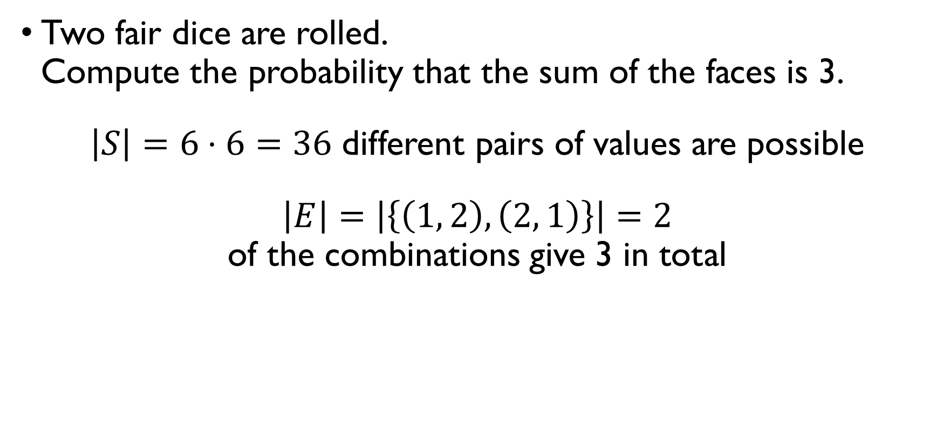
Rolling dice
Two fair dice are rolled. Compute the probability that the sum of the faces is 3.
$\left|S\right|=6⋅6=36$ different pairs of values are possible
$\left|E\right|=\left|\left\{\left(1, 2\right), \left(2, 1\right)\right\}\right|=2$ of the combinations give 3 in total
$$P\left(E\right)=\frac{2}{36}=\frac{1}{18}≈0.03$$

Slide 42
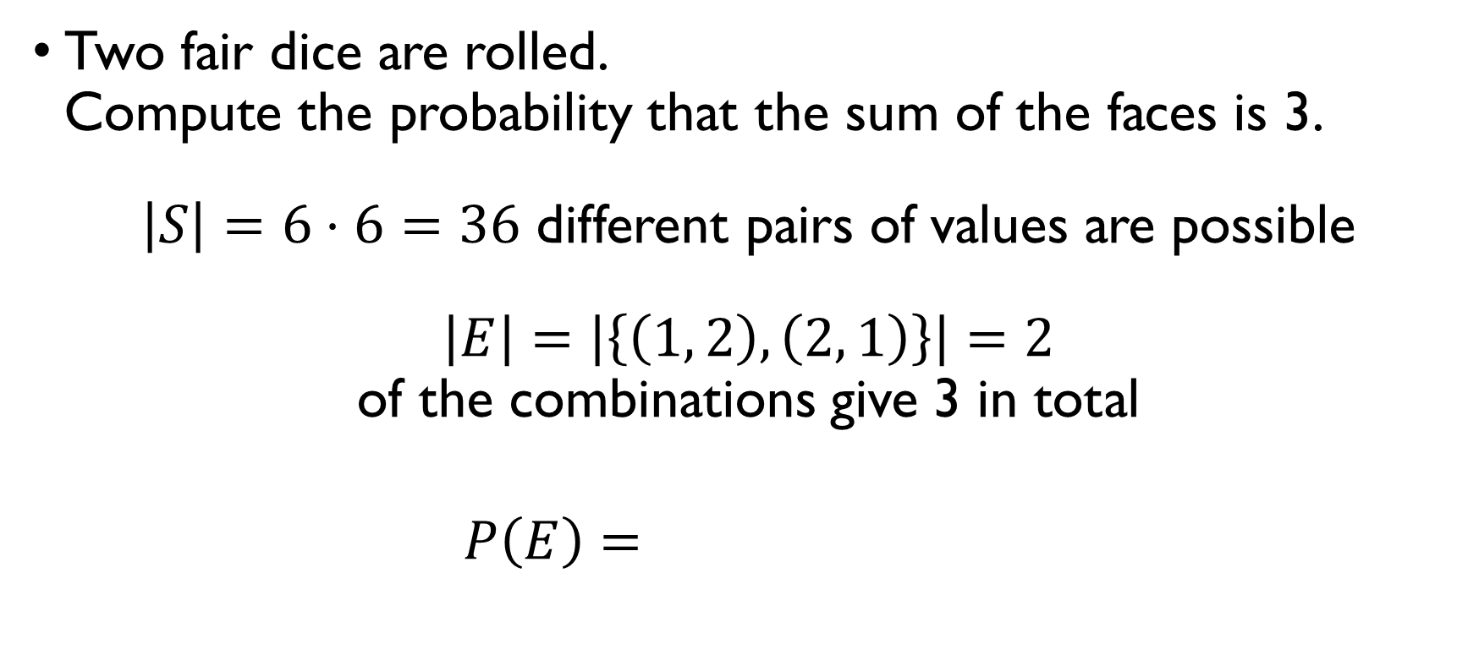
Rolling dice
Two fair dice are rolled. Compute the probability that the sum of the faces is 3.
$\left|S\right|=6⋅6=36$ different pairs of values are possible
$\left|E\right|=\left|\left\{\left(1, 2\right), \left(2, 1\right)\right\}\right|=2$ of the combinations give 3 in total
$$P\left(E\right)=\frac{2}{36}=\frac{1}{18}≈0.03$$

Slide 43
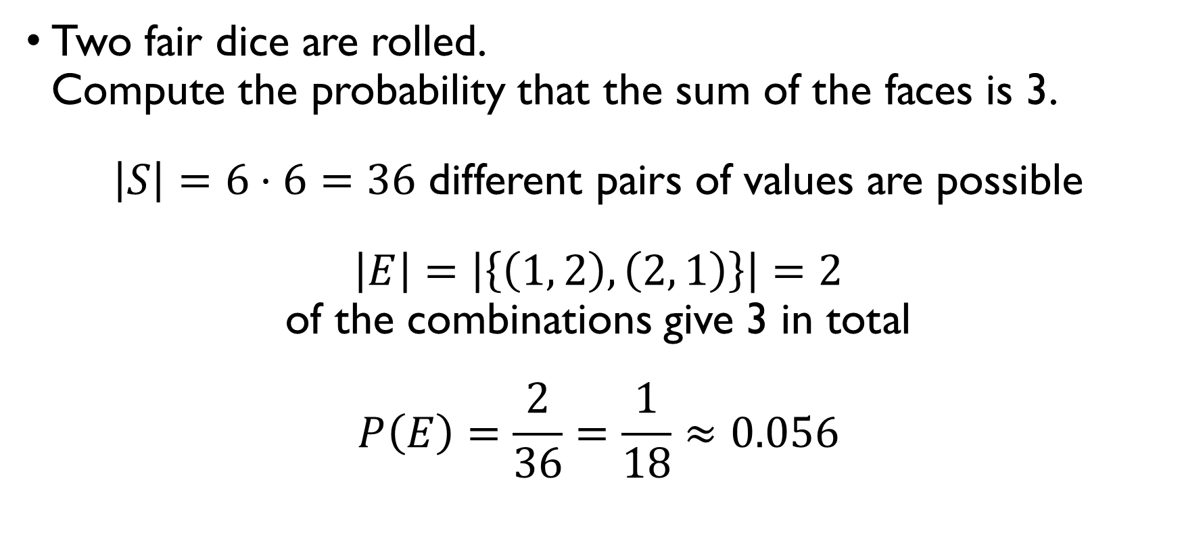
Rolling dice
Two fair dice are rolled. Compute the probability that the sum of the faces is 3.
$\left|S\right|=6⋅6=36$ different pairs of values are possible
$\left|E\right|=\left|\left\{\left(1, 2\right), \left(2, 1\right)\right\}\right|=2$ of the combinations give 3 in total
$$P\left(E\right)=\frac{2}{36}=\frac{1}{18}≈0.056$$

Slide 44
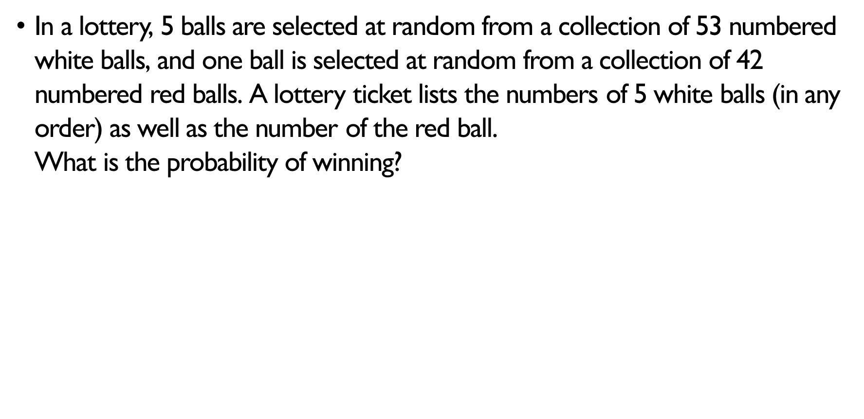
lottery
In a lottery, 5 balls are selected at random from a collection of 53 numbered white balls, and one ball is selected at random from a collection of 42 numbered red balls. A lottery ticket lists the numbers of 5 white balls (in any order) as well as the number of the red ball. What is the probability of winning? Ways of choosing 5 white balls: $C\left(53, 5\right)$ Ways of choosing 1 red ball: $C\left(42, 1\right)=42$ Total number of combinations: $C\left(53, 5\right)⋅42=120,526,770$ Number of winning combinations: $1$ Probability of winning: $1/\left[C\left(53, 5\right)⋅42\right]≈0.0000000083$

Slide 45
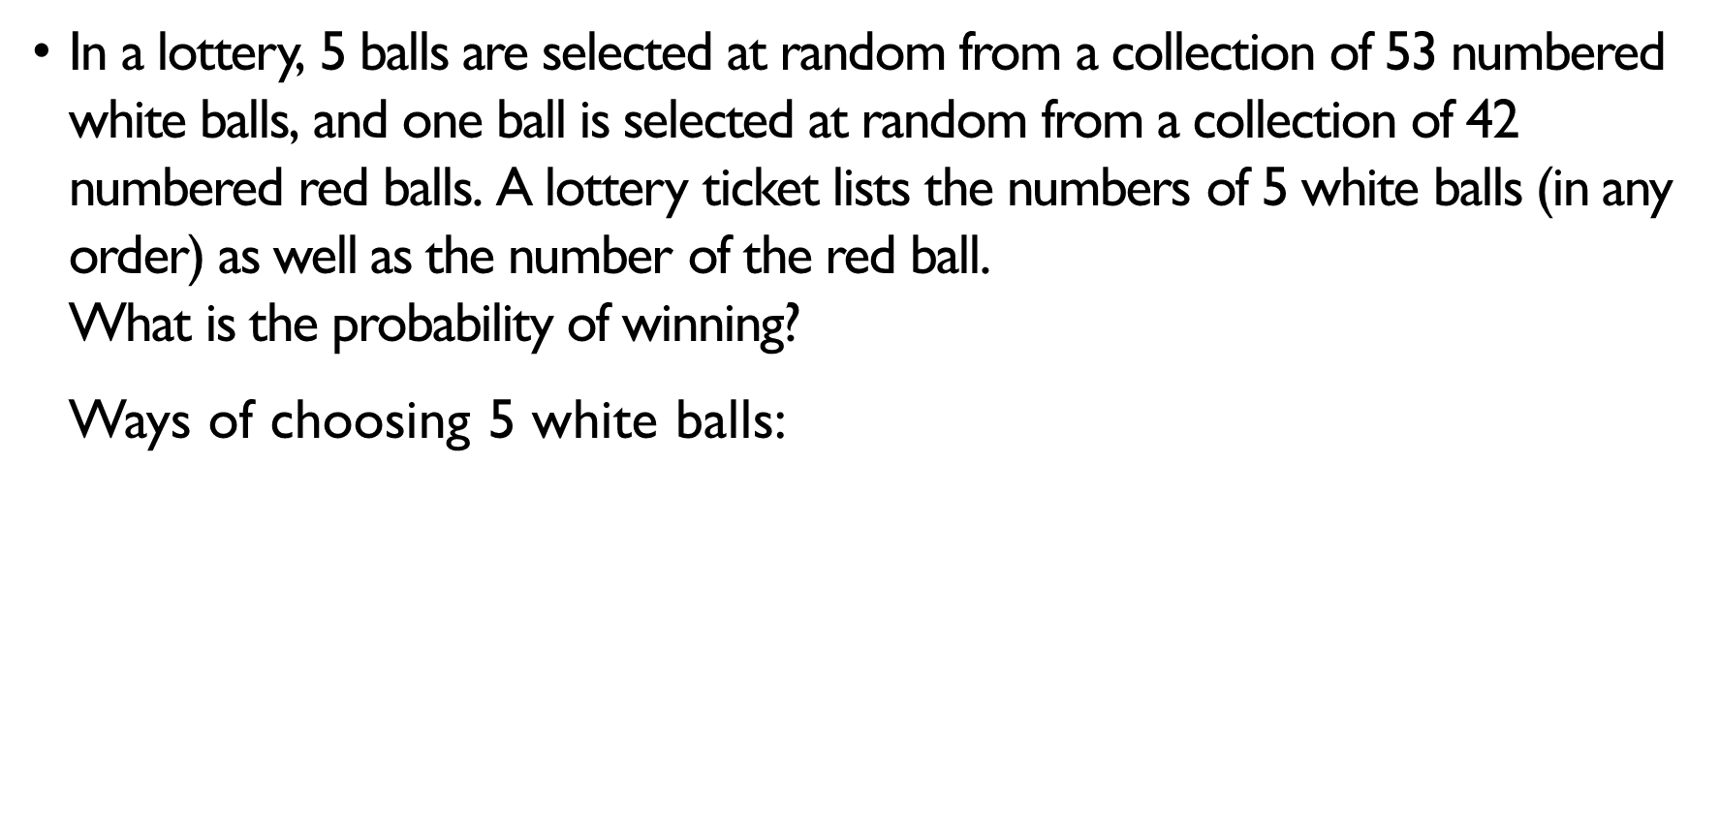
lottery
In a lottery, 5 balls are selected at random from a collection of 53 numbered white balls, and one ball is selected at random from a collection of 42 numbered red balls. A lottery ticket lists the numbers of 5 white balls (in any order) as well as the number of the red ball. What is the probability of winning? Ways of choosing 5 white balls: $C\left(53, 5\right)$ Ways of choosing 1 red ball: $C\left(42, 1\right)=42$ Total number of combinations: $C\left(53, 5\right)⋅42=120,526,770$ Number of winning combinations: $1$ Probability of winning: $1/\left[C\left(53, 5\right)⋅42\right]≈0.0000000083$

Slide 46
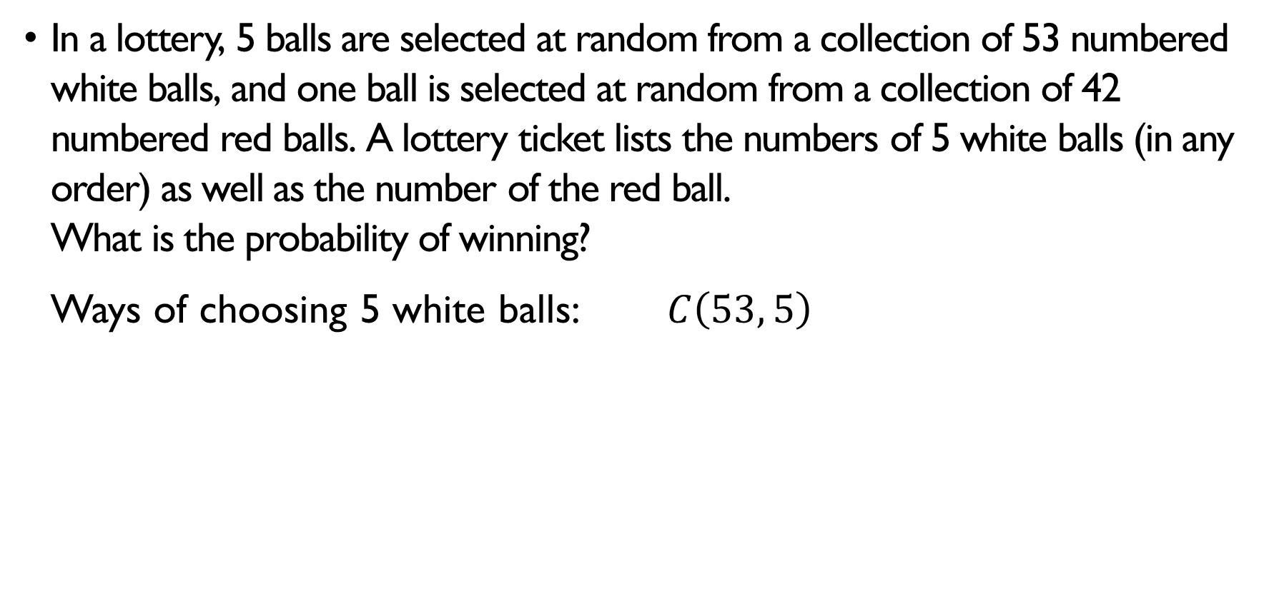
lottery
In a lottery, 5 balls are selected at random from a collection of 53 numbered white balls, and one ball is selected at random from a collection of 42 numbered red balls. A lottery ticket lists the numbers of 5 white balls (in any order) as well as the number of the red ball. What is the probability of winning? Ways of choosing 5 white balls: $C\left(53, 5\right)$ Ways of choosing 1 red ball: $C\left(42, 1\right)=42$ Total number of combinations: $C\left(53, 5\right)⋅42=120,526,770$ Number of winning combinations: $1$ Probability of winning: $1/\left[C\left(53, 5\right)⋅42\right]≈0.0000000083$

Slide 47
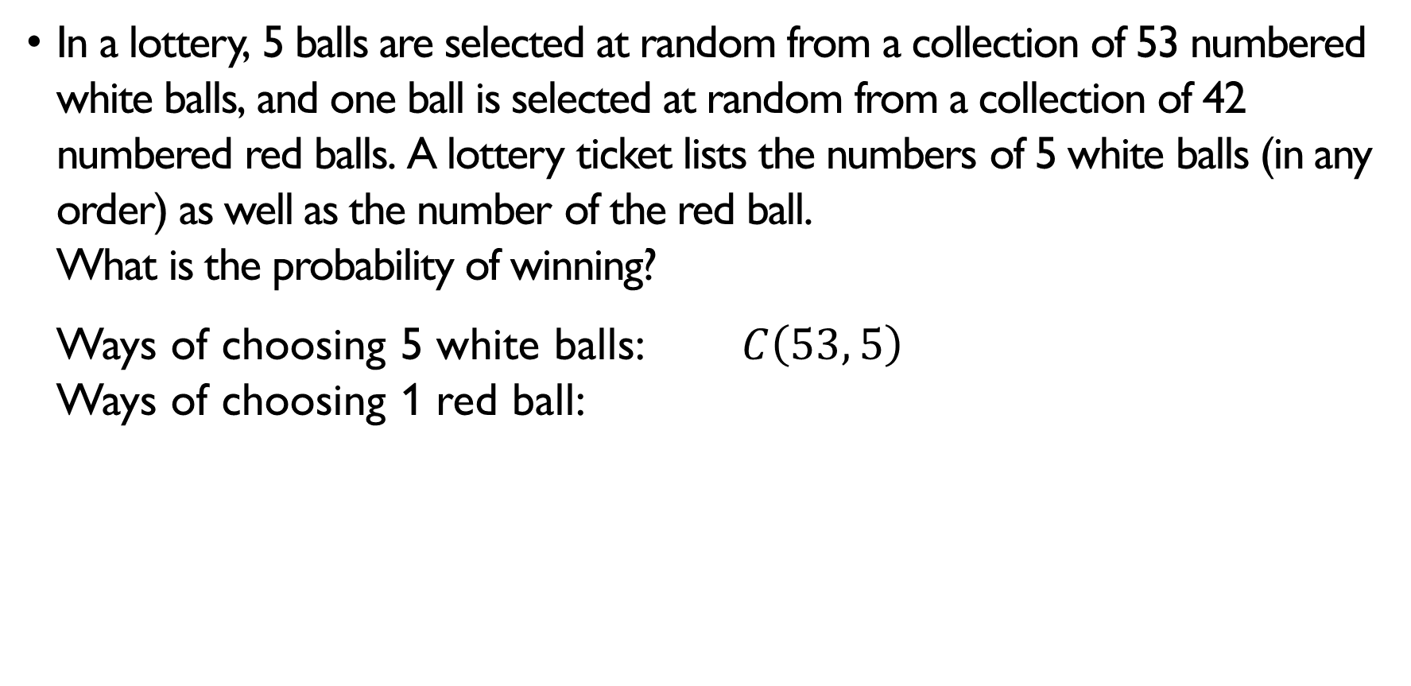
lottery
In a lottery, 5 balls are selected at random from a collection of 53 numbered white balls, and one ball is selected at random from a collection of 42 numbered red balls. A lottery ticket lists the numbers of 5 white balls (in any order) as well as the number of the red ball. What is the probability of winning? Ways of choosing 5 white balls: $C\left(53, 5\right)$ Ways of choosing 1 red ball: $C\left(42, 1\right)=42$ Total number of combinations: $C\left(53, 5\right)⋅42=120,526,770$ Number of winning combinations: $1$ Probability of winning: $1/\left[C\left(53, 5\right)⋅42\right]≈0.0000000083$

Slide 48
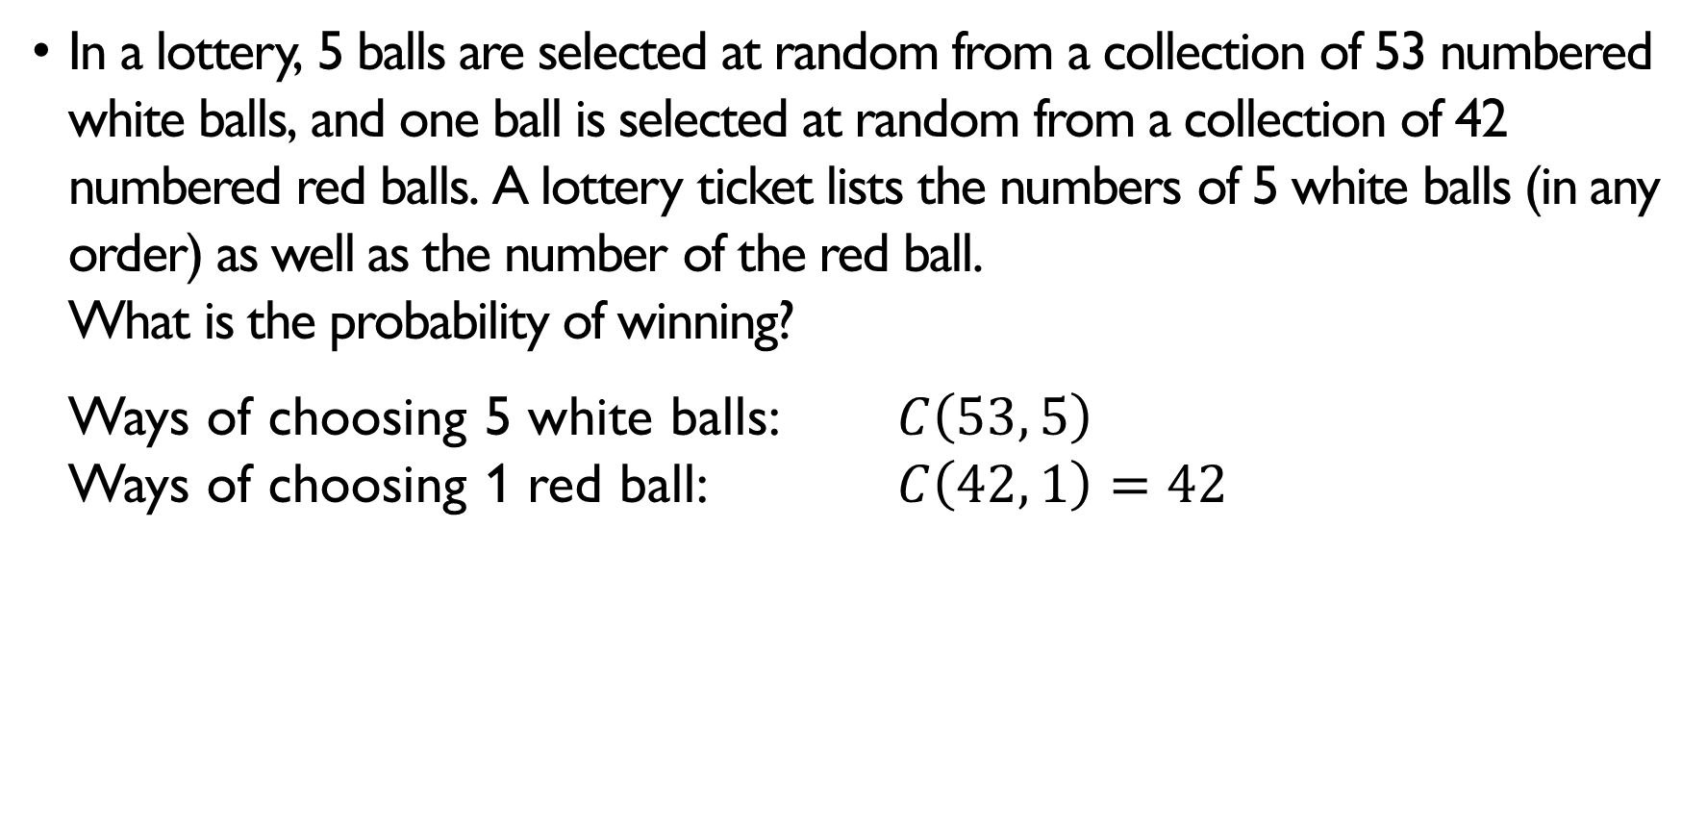
lottery
In a lottery, 5 balls are selected at random from a collection of 53 numbered white balls, and one ball is selected at random from a collection of 42 numbered red balls. A lottery ticket lists the numbers of 5 white balls (in any order) as well as the number of the red ball. What is the probability of winning? Ways of choosing 5 white balls: $C\left(53, 5\right)$ Ways of choosing 1 red ball: $C\left(42, 1\right)=42$ Total number of combinations: $C\left(53, 5\right)⋅42=120,526,770$ Number of winning combinations: $1$ Probability of winning: $1/\left[C\left(53, 5\right)⋅42\right]≈0.0000000083$

Slide 49
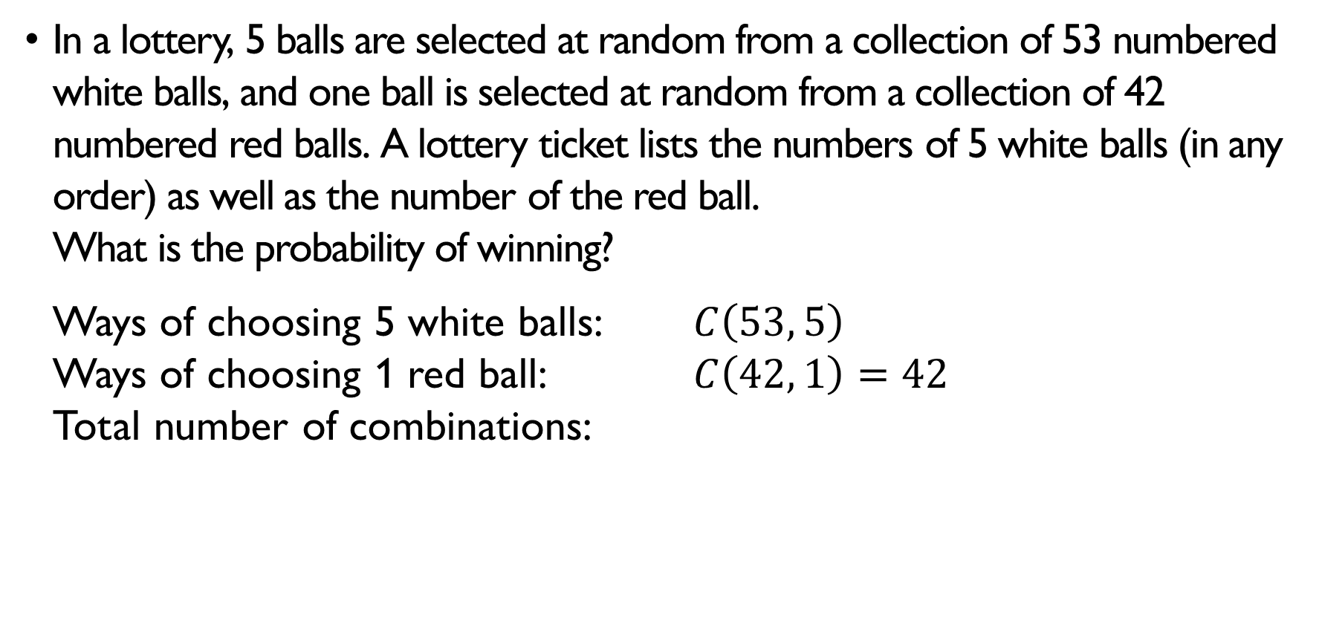
lottery
In a lottery, 5 balls are selected at random from a collection of 53 numbered white balls, and one ball is selected at random from a collection of 42 numbered red balls. A lottery ticket lists the numbers of 5 white balls (in any order) as well as the number of the red ball. What is the probability of winning? Ways of choosing 5 white balls: $C\left(53, 5\right)$ Ways of choosing 1 red ball: $C\left(42, 1\right)=42$ Total number of combinations: $C\left(53, 5\right)⋅42=120,526,770$ Number of winning combinations: $1$ Probability of winning: $1/\left[C\left(53, 5\right)⋅42\right]≈0.0000000083$

Slide 50
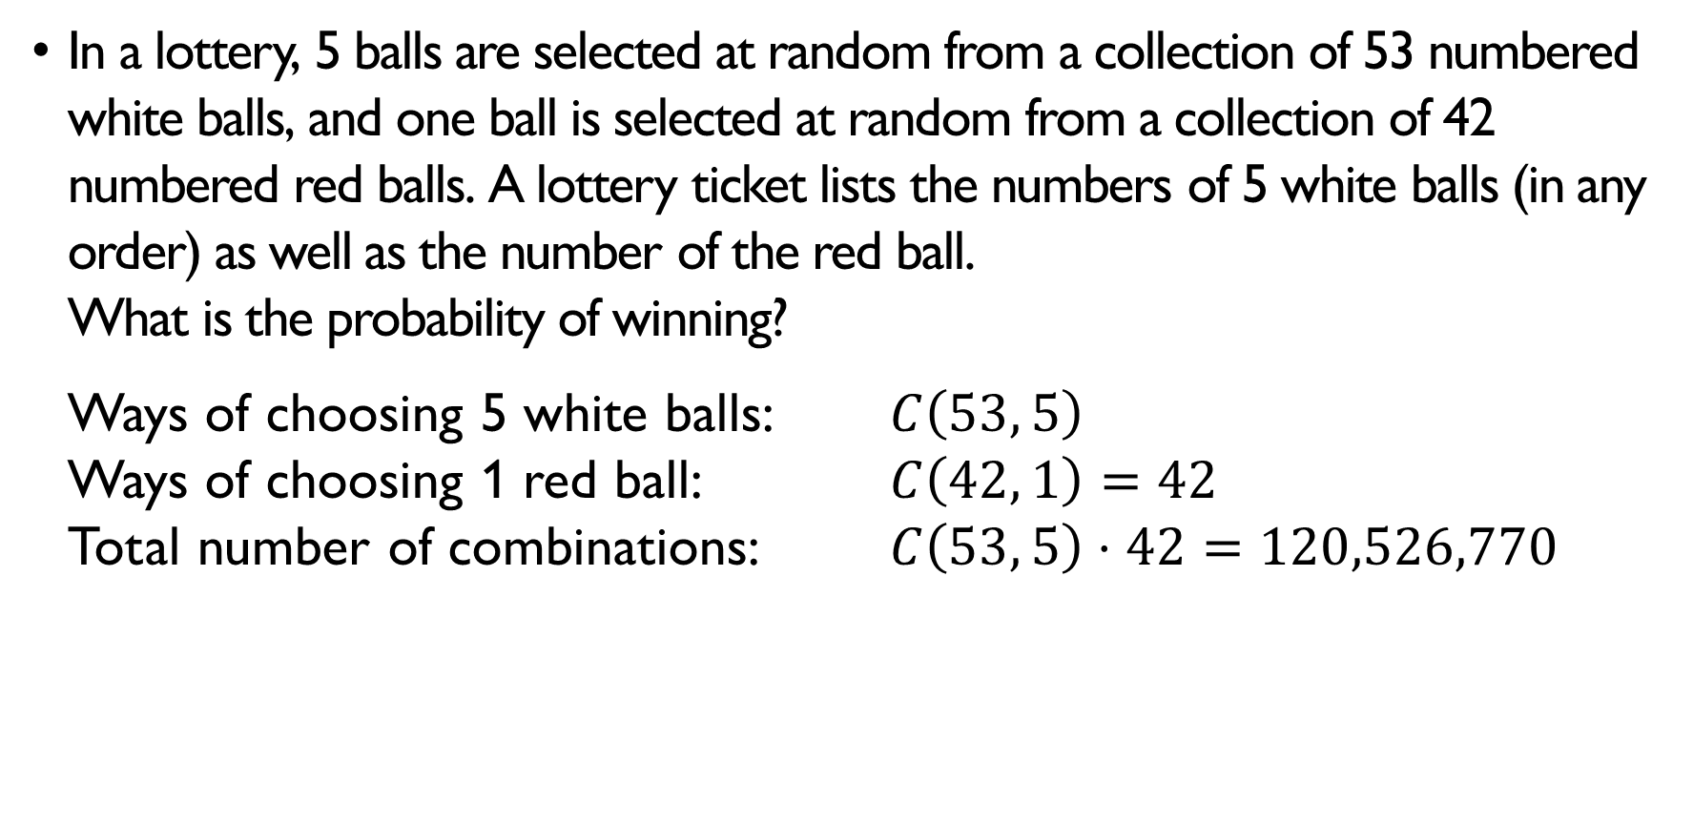
lottery
In a lottery, 5 balls are selected at random from a collection of 53 numbered white balls, and one ball is selected at random from a collection of 42 numbered red balls. A lottery ticket lists the numbers of 5 white balls (in any order) as well as the number of the red ball. What is the probability of winning? Ways of choosing 5 white balls: $C\left(53, 5\right)$ Ways of choosing 1 red ball: $C\left(42, 1\right)=42$ Total number of combinations: $C\left(53, 5\right)⋅42=120,526,770$ Number of winning combinations: $1$ Probability of winning: $1/\left[C\left(53, 5\right)⋅42\right]≈0.0000000083$

Slide 51
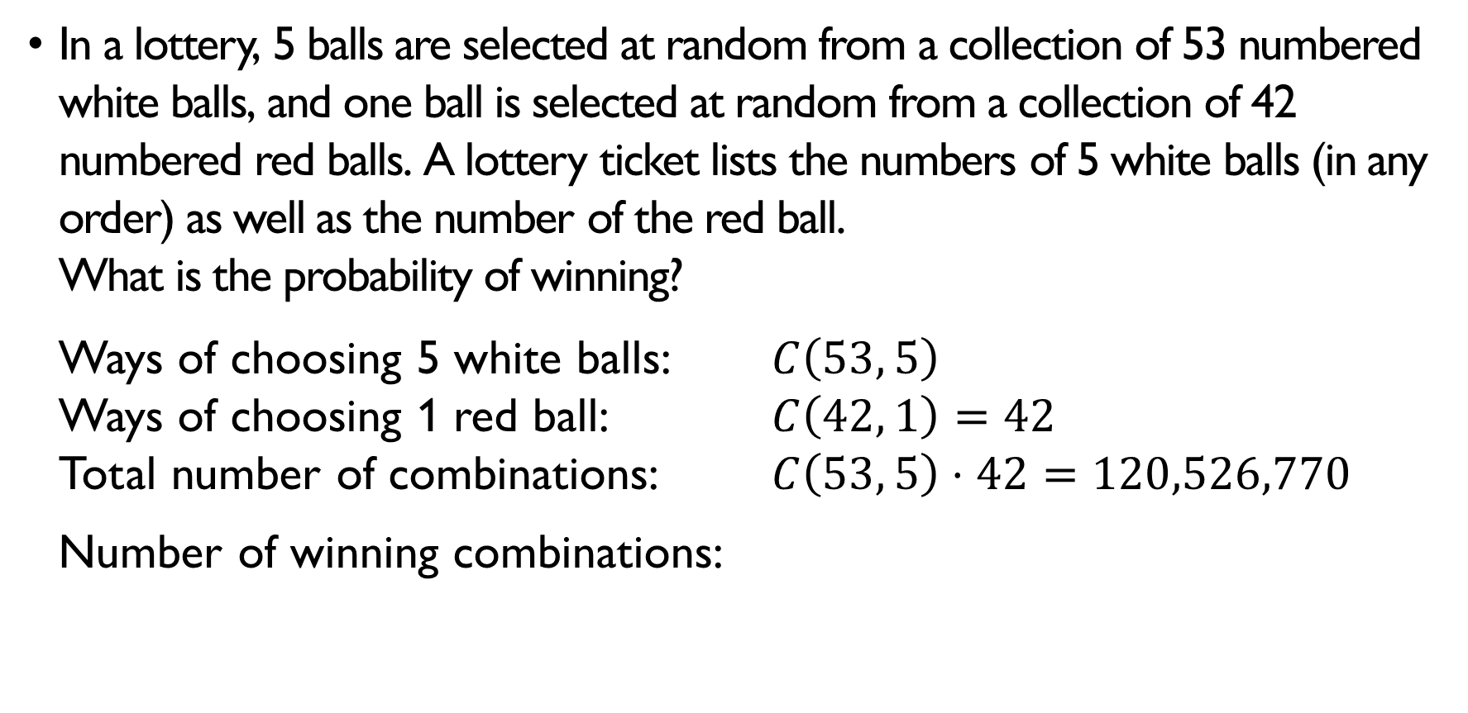
lottery
In a lottery, 5 balls are selected at random from a collection of 53 numbered white balls, and one ball is selected at random from a collection of 42 numbered red balls. A lottery ticket lists the numbers of 5 white balls (in any order) as well as the number of the red ball. What is the probability of winning? Ways of choosing 5 white balls: $C\left(53, 5\right)$ Ways of choosing 1 red ball: $C\left(42, 1\right)=42$ Total number of combinations: $C\left(53, 5\right)⋅42=120,526,770$ Number of winning combinations: $1$ Probability of winning: $1/\left[C\left(53, 5\right)⋅42\right]≈0.0000000083$

Slide 52
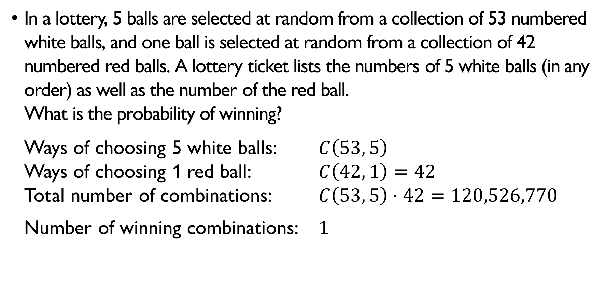
lottery
In a lottery, 5 balls are selected at random from a collection of 53 numbered white balls, and one ball is selected at random from a collection of 42 numbered red balls. A lottery ticket lists the numbers of 5 white balls (in any order) as well as the number of the red ball. What is the probability of winning? Ways of choosing 5 white balls: $C\left(53, 5\right)$ Ways of choosing 1 red ball: $C\left(42, 1\right)=42$ Total number of combinations: $C\left(53, 5\right)⋅42=120,526,770$ Number of winning combinations: $1$ Probability of winning: $1/\left[C\left(53, 5\right)⋅42\right]≈0.0000000083$

Slide 53
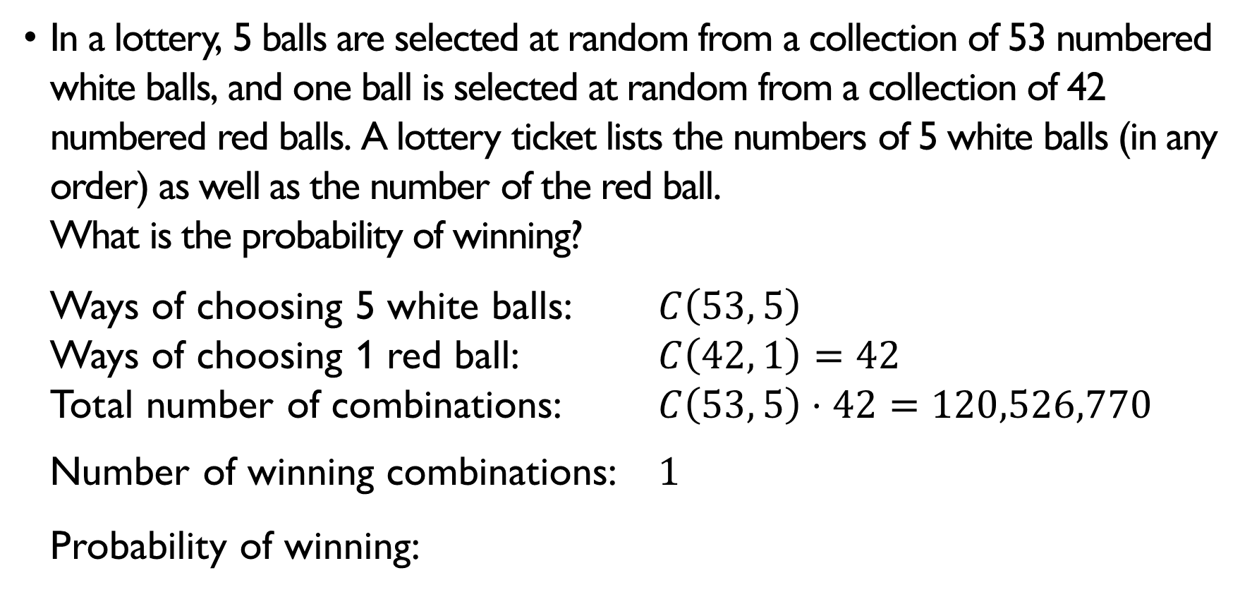
lottery
In a lottery, 5 balls are selected at random from a collection of 53 numbered white balls, and one ball is selected at random from a collection of 42 numbered red balls. A lottery ticket lists the numbers of 5 white balls (in any order) as well as the number of the red ball. What is the probability of winning? Ways of choosing 5 white balls: $C\left(53, 5\right)$ Ways of choosing 1 red ball: $C\left(42, 1\right)=42$ Total number of combinations: $C\left(53, 5\right)⋅42=120,526,770$ Number of winning combinations: $1$ Probability of winning: $1/\left[C\left(53, 5\right)⋅42\right]≈0.0000000083$

Slide 54
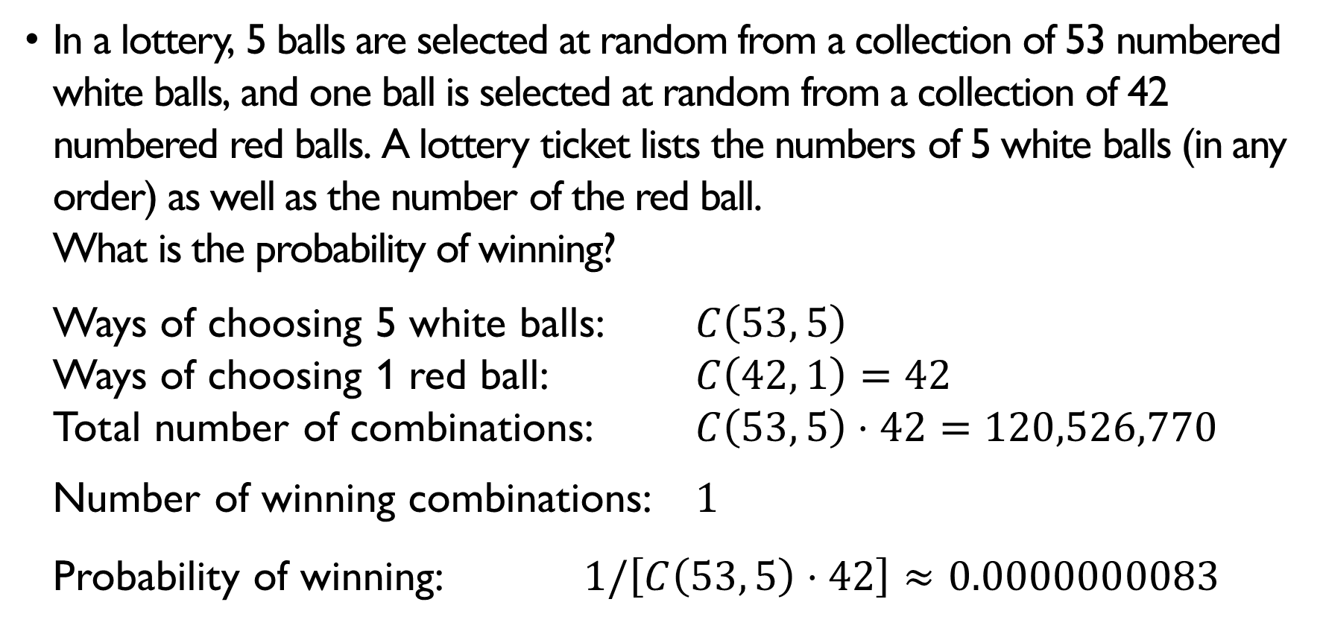
lottery
In a lottery, 5 balls are selected at random from a collection of 53 numbered white balls, and one ball is selected at random from a collection of 42 numbered red balls. A lottery ticket lists the numbers of 5 white balls (in any order) as well as the number of the red ball. What is the probability of winning? Ways of choosing 5 white balls: $C\left(53, 5\right)$ Ways of choosing 1 red ball: $C\left(42, 1\right)=42$ Total number of combinations: $C\left(53, 5\right)⋅42=120,526,770$ Number of winning combinations: $1$ Probability of winning: $1/\left[C\left(53, 5\right)⋅42\right]≈0.0000000083$

Slide 55

Boys and girls
Assuming equal outcomes, calculate the probability that …
… in a 3-child family, there are 2 boys and 1 girl $\left|S\right|=2⋅2⋅2=8$ possible $\left|E\right|=C\left(3, 2\right)⋅1⋅1⋅1=3$ different families with 2 boys and 1 girl $P\left(E\right)=3/8$
… in a 4-child family, there are 2 boys and 2 girls $\left|S\right|=2^{4}$ $\left|E\right|=C\left(4,2\right)=6$ different families with 2 boys and 2 girls $P\left(E\right)=3/4$

Slide 56
Boys and girls
Assuming equal outcomes, calculate the probability that …
… in a 3-child family, there are 2 boys and 1 girl $\left|S\right|=2⋅2⋅2=8$ possible $\left|E\right|=C\left(3, 2\right)⋅1⋅1⋅1=3$ different families with 2 boys and 1 girl $P\left(E\right)=3/8$
… in a 4-child family, there are 2 boys and 2 girls $\left|S\right|=2^{4}$ $\left|E\right|=C\left(4,2\right)=6$ different families with 2 boys and 2 girls $P\left(E\right)=3/4$

Slide 57

Boys and girls
Assuming equal outcomes, calculate the probability that …
… in a 3-child family, there are 2 boys and 1 girl $\left|S\right|=2⋅2⋅2=8$ possible $\left|E\right|=C\left(3, 2\right)⋅1⋅1⋅1=3$ different families with 2 boys and 1 girl $P\left(E\right)=3/8$
… in a 4-child family, there are 2 boys and 2 girls $\left|S\right|=2^{4}$ $\left|E\right|=C\left(4,2\right)=6$ different families with 2 boys and 2 girls $P\left(E\right)=3/4$

Slide 58
Boys and girls
Assuming equal outcomes, calculate the probability that …
… in a 3-child family, there are 2 boys and 1 girl $\left|S\right|=2⋅2⋅2=8$ possible $\left|E\right|=C\left(3, 2\right)⋅1⋅1⋅1=3$ different families with 2 boys and 1 girl $P\left(E\right)=3/8$
… in a 4-child family, there are 2 boys and 2 girls $\left|S\right|=2^{4}$ $\left|E\right|=C\left(4,2\right)=6$ different families with 2 boys and 2 girls $P\left(E\right)=3/4$

Slide 59

Boys and girls
Assuming equal outcomes, calculate the probability that …
… in a 3-child family, there are 2 boys and 1 girl $\left|S\right|=2⋅2⋅2=8$ possible $\left|E\right|=C\left(3, 2\right)⋅1⋅1⋅1=3$ different families with 2 boys and 1 girl $P\left(E\right)=3/8$
… in a 4-child family, there are 2 boys and 2 girls $\left|S\right|=2^{4}$ $\left|E\right|=C\left(4,2\right)=6$ different families with 2 boys and 2 girls $P\left(E\right)=3/4$

Slide 60

Boys and girls
Assuming equal outcomes, calculate the probability that …
… in a 3-child family, there are 2 boys and 1 girl $\left|S\right|=2⋅2⋅2=8$ possible $\left|E\right|=C\left(3, 2\right)⋅1⋅1⋅1=3$ different families with 2 boys and 1 girl $P\left(E\right)=3/8$
… in a 4-child family, there are 2 boys and 2 girls $\left|S\right|=2^{4}$ $\left|E\right|=C\left(4,2\right)=6$ different families with 2 boys and 2 girls $P\left(E\right)=3/4$

Slide 61

Boys and girls
Assuming equal outcomes, calculate the probability that …
… in a 3-child family, there are 2 boys and 1 girl $\left|S\right|=2⋅2⋅2=8$ possible $\left|E\right|=C\left(3, 2\right)⋅1⋅1⋅1=3$ different families with 2 boys and 1 girl $P\left(E\right)=3/8$
… in a 4-child family, there are 2 boys and 2 girls $\left|S\right|=2^{4}$ $\left|E\right|=C\left(4,2\right)=6$ different families with 2 boys and 2 girls $P\left(E\right)=3/4$

Slide 62

Boys and girls
Assuming equal outcomes, calculate the probability that …
… in a 3-child family, there are 2 boys and 1 girl $\left|S\right|=2⋅2⋅2=8$ possible $\left|E\right|=C\left(3, 2\right)⋅1⋅1⋅1=3$ different families with 2 boys and 1 girl $P\left(E\right)=3/8$
… in a 4-child family, there are 2 boys and 2 girls $\left|S\right|=2^{4}$ $\left|E\right|=C\left(4,2\right)=6$ different families with 2 boys and 2 girls $P\left(E\right)=3/4$

Slide 63

Boys and girls
Assuming equal outcomes, calculate the probability that …
… in a 3-child family, there are 2 boys and 1 girl $\left|S\right|=2⋅2⋅2=8$ possible $\left|E\right|=C\left(3, 2\right)⋅1⋅1⋅1=3$ different families with 2 boys and 1 girl $P\left(E\right)=3/8$
… in a 4-child family, there are 2 boys and 2 girls $\left|S\right|=2^{4}$ $\left|E\right|=C\left(4,2\right)=6$ different families with 2 boys and 2 girls $P\left(E\right)=3/4$

Slide 64

Boys and girls
Assuming equal outcomes, calculate the probability that …
… in a 3-child family, there are 2 boys and 1 girl $\left|S\right|=2⋅2⋅2=8$ possible $\left|E\right|=C\left(3, 2\right)⋅1⋅1⋅1=3$ different families with 2 boys and 1 girl $P\left(E\right)=3/8$
… in a 4-child family, there are 2 boys and 2 girls $\left|S\right|=2^{4}$ $\left|E\right|=C\left(4,2\right)=6$ different families with 2 boys and 2 girls $P\left(E\right)=3/4$

Slide 65

Boys and girls
Assuming equal outcomes, calculate the probability that …
… in a 3-child family, there are 2 boys and 1 girl $\left|S\right|=2⋅2⋅2=8$ possible $\left|E\right|=C\left(3, 2\right)⋅1⋅1⋅1=3$ different families with 2 boys and 1 girl $P\left(E\right)=3/8$
… in a 4-child family, there are 2 boys and 2 girls $\left|S\right|=2^{4}$ $\left|E\right|=C\left(4,2\right)=6$ different families with 2 boys and 2 girls $P\left(E\right)=3/4$

Slide 66

Boys and girls
Assuming equal outcomes, calculate the probability that …
… in a 3-child family, there are 2 boys and 1 girl $\left|S\right|=2⋅2⋅2=8$ possible $\left|E\right|=C\left(3, 2\right)⋅1⋅1⋅1=3$ different families with 2 boys and 1 girl $P\left(E\right)=3/8$
… in a 4-child family, there are 2 boys and 2 girls $\left|S\right|=2^{4}$ $\left|E\right|=C\left(4,2\right)=6$ different families with 2 boys and 2 girls $P\left(E\right)=3/4$

Slide 67

Boys and girls
Assuming equal outcomes, calculate the probability that …
… in a 3-child family, there are 2 boys and 1 girl $\left|S\right|=2⋅2⋅2=8$ possible $\left|E\right|=C\left(3, 2\right)⋅1⋅1⋅1=3$ different families with 2 boys and 1 girl $P\left(E\right)=3/8$
… in a 4-child family, there are 2 boys and 2 girls $\left|S\right|=2^{4}$ $\left|E\right|=C\left(4,2\right)=6$ different families with 2 boys and 2 girls $P\left(E\right)=3/8$

Slide 68

Random number
A computer is generating a random number between 0 and 100. What is the probability that …
… it doesn’t contain digit 7? $\left|S\right|=101$ different numbers $\left|E\right|=9+8⋅9+1=82$ numbers don’t contain 7 $\left|P\right|=82/101≈0.81$
… it contains unique digits (e.g., 123 but 111)? $\left|S\right|=101$ different numbers $\left|E\right|=10+9⋅9=91$ numbers with unique digits $\left|P\right|=91/101≈0.9$

Slide 69

Random number
A computer is generating a random number between 0 and 100. What is the probability that …
… it doesn’t contain digit 7? $\left|S\right|=101$ different numbers $\left|E\right|=9+8⋅9+1=82$ numbers don’t contain 7 $\left|P\right|=82/101≈0.81$
… it contains unique digits (e.g., 123 but 111)? $\left|S\right|=101$ different numbers $\left|E\right|=10+9⋅9=91$ numbers with unique digits $\left|P\right|=91/101≈0.9$

Slide 70

Random number
A computer is generating a random number between 0 and 100. What is the probability that …
… it doesn’t contain digit 7? $\left|S\right|=101$ different numbers $\left|E\right|=9+8⋅9+1=82$ numbers don’t contain 7 $\left|P\right|=82/101≈0.81$
… it contains unique digits (e.g., 123 but 111)? $\left|S\right|=101$ different numbers $\left|E\right|=10+9⋅9=91$ numbers with unique digits $\left|P\right|=91/101≈0.9$

Slide 71

Random number
A computer is generating a random number between 0 and 100. What is the probability that …
… it doesn’t contain digit 7? $\left|S\right|=101$ different numbers $\left|E\right|=9+8⋅9+1=82$ numbers don’t contain 7 $\left|P\right|=82/101≈0.81$
… it contains unique digits (e.g., 123 but 111)? $\left|S\right|=101$ different numbers $\left|E\right|=10+9⋅9=91$ numbers with unique digits $\left|P\right|=91/101≈0.9$

Slide 72

Random number
A computer is generating a random number between 0 and 100. What is the probability that …
… it doesn’t contain digit 7? $\left|S\right|=101$ different numbers $\left|E\right|=9+8⋅9+1=82$ numbers don’t contain 7 $\left|P\right|=82/101≈0.81$
… it contains unique digits (e.g., 123 but 111)? $\left|S\right|=101$ different numbers $\left|E\right|=10+9⋅9=91$ numbers with unique digits $\left|P\right|=91/101≈0.9$

Slide 73

Random number
A computer is generating a random number between 0 and 100. What is the probability that …
… it doesn’t contain digit 7? $\left|S\right|=101$ different numbers $\left|E\right|=9+8⋅9+1=82$ numbers don’t contain 7 $\left|P\right|=82/101≈0.81$
… it contains unique digits (e.g., 123 but 111)? $\left|S\right|=101$ different numbers $\left|E\right|=10+9⋅9=91$ numbers with unique digits $\left|P\right|=91/101≈0.9$

Slide 74

Random number
A computer is generating a random number between 0 and 100. What is the probability that …
… it doesn’t contain digit 7? $\left|S\right|=101$ different numbers $\left|E\right|=9+8⋅9+1=82$ numbers don’t contain 7 $\left|P\right|=82/101≈0.81$
… it contains unique digits (e.g., 123 but 111)? $\left|S\right|=101$ different numbers $\left|E\right|=10+9⋅9=91$ numbers with unique digits $\left|P\right|=91/101≈0.9$

Slide 75

Random number
A computer is generating a random number between 0 and 100. What is the probability that …
… it doesn’t contain digit 7? $\left|S\right|=101$ different numbers $\left|E\right|=9+8⋅9+1=82$ numbers don’t contain 7 $\left|P\right|=82/101≈0.81$
… it contains unique digits (e.g., 123 but 111)? $\left|S\right|=101$ different numbers $\left|E\right|=10+9⋅9=91$ numbers with unique digits $\left|P\right|=91/101≈0.9$

Slide 76

Random number
A computer is generating a random number between 0 and 100. What is the probability that …
… it doesn’t contain digit 7? $\left|S\right|=101$ different numbers $\left|E\right|=9+8⋅9+1=82$ numbers don’t contain 7 $\left|P\right|=82/101≈0.81$
… it contains unique digits (e.g., 123 but 111)? $\left|S\right|=101$ different numbers $\left|E\right|=10+9⋅9=91$ numbers with unique digits $\left|P\right|=91/101≈0.9$

Slide 77

Random number
A computer is generating a random number between 0 and 100. What is the probability that …
… it doesn’t contain digit 7? $\left|S\right|=101$ different numbers $\left|E\right|=9+8⋅9+1=82$ numbers don’t contain 7 $\left|P\right|=82/101≈0.81$
… it contains unique digits (e.g., 123 but 111)? $\left|S\right|=101$ different numbers $\left|E\right|=10+9⋅9=91$ numbers with unique digits $\left|P\right|=91/101≈0.9$

Slide 78

Random number
A computer is generating a random number between 0 and 100. What is the probability that …
… it doesn’t contain digit 7? $\left|S\right|=101$ different numbers $\left|E\right|=9+8⋅9+1=82$ numbers don’t contain 7 $\left|P\right|=82/101≈0.81$
… it contains unique digits (e.g., 123 but 111)? $\left|S\right|=101$ different numbers $\left|E\right|=10+9⋅9=91$ numbers with unique digits $\left|P\right|=91/101≈0.9$

Slide 79

Random number
A computer is generating a random number between 0 and 100. What is the probability that …
… it doesn’t contain digit 7? $\left|S\right|=101$ different numbers $\left|E\right|=9+8⋅9+1=82$ numbers don’t contain 7 $\left|P\right|=82/101≈0.81$
… it contains unique digits (e.g., 123 but 111)? $\left|S\right|=101$ different numbers $\left|E\right|=10+9⋅9=91$ numbers with unique digits $\left|P\right|=91/101≈0.9$

Slide 80

Random number
A computer is generating a random number between 0 and 100. What is the probability that …
… it doesn’t contain digit 7? $\left|S\right|=101$ different numbers $\left|E\right|=9+8⋅9+1=82$ numbers don’t contain 7 $\left|P\right|=82/101≈0.81$
… it contains unique digits (e.g., 123 but 111)? $\left|S\right|=101$ different numbers $\left|E\right|=10+9⋅9=91$ numbers with unique digits $\left|P\right|=91/101≈0.9$

Slide 81

Class picture
At school, 4 girls and 6 boys are lining up for a class picture in a random order. What is the probability that …
… all girls are standing next to each other? $\left|S\right|=10!$ possible permutations of 10 kids $\left|E\right|=4!⋅7!$ possible permutations where girls are together $P\left(E\right)=\frac{4!7!}{10!}≈0.033$
… all the girls are next to each other and all the boys as well? $\left|S\right|=10!$ possible permutations of 10 kids $\left|E\right|=4!⋅6!⋅2!$ permutations where girls are together and boys are together $P\left(E\right)=\frac{4!6!2!}{10!}≈0.0096$

Slide 82

Class picture
At school, 4 girls and 6 boys are lining up for a class picture in a random order. What is the probability that …
… all girls are standing next to each other? $\left|S\right|=10!$ possible permutations of 10 kids $\left|E\right|=4!⋅7!$ possible permutations where girls are together $P\left(E\right)=\frac{4!7!}{10!}≈0.033$
… all the girls are next to each other and all the boys as well? $\left|S\right|=10!$ possible permutations of 10 kids $\left|E\right|=4!⋅6!⋅2!$ permutations where girls are together and boys are together $P\left(E\right)=\frac{4!6!2!}{10!}≈0.0096$

Slide 83

Class picture
At school, 4 girls and 6 boys are lining up for a class picture in a random order. What is the probability that …
… all girls are standing next to each other? $\left|S\right|=10!$ possible permutations of 10 kids $\left|E\right|=4!⋅7!$ possible permutations where girls are together $P\left(E\right)=\frac{4!7!}{10!}≈0.033$
… all the girls are next to each other and all the boys as well? $\left|S\right|=10!$ possible permutations of 10 kids $\left|E\right|=4!⋅6!⋅2!$ permutations where girls are together and boys are together $P\left(E\right)=\frac{4!6!2!}{10!}≈0.0096$

Slide 84

Class picture
At school, 4 girls and 6 boys are lining up for a class picture in a random order. What is the probability that …
… all girls are standing next to each other? $\left|S\right|=10!$ possible permutations of 10 kids $\left|E\right|=4!⋅7!$ possible permutations where girls are together $P\left(E\right)=\frac{4!7!}{10!}≈0.033$
… all the girls are next to each other and all the boys as well? $\left|S\right|=10!$ possible permutations of 10 kids $\left|E\right|=4!⋅6!⋅2!$ permutations where girls are together and boys are together $P\left(E\right)=\frac{4!6!2!}{10!}≈0.0096$

Slide 85

Class picture
At school, 4 girls and 6 boys are lining up for a class picture in a random order. What is the probability that …
… all girls are standing next to each other? $\left|S\right|=10!$ possible permutations of 10 kids $\left|E\right|=4!⋅7!$ possible permutations where girls are together $P\left(E\right)=\frac{4!7!}{10!}≈0.033$
… all the girls are next to each other and all the boys as well? $\left|S\right|=10!$ possible permutations of 10 kids $\left|E\right|=4!⋅6!⋅2!$ permutations where girls are together and boys are together $P\left(E\right)=\frac{4!6!2!}{10!}≈0.0096$

Slide 86

Class picture
At school, 4 girls and 6 boys are lining up for a class picture in a random order. What is the probability that …
… all girls are standing next to each other? $\left|S\right|=10!$ possible permutations of 10 kids $\left|E\right|=4!⋅7!$ possible permutations where girls are together $P\left(E\right)=\frac{4!7!}{10!}≈0.033$
… all the girls are next to each other and all the boys as well? $\left|S\right|=10!$ possible permutations of 10 kids $\left|E\right|=4!⋅6!⋅2!$ permutations where girls are together and boys are together $P\left(E\right)=\frac{4!6!2!}{10!}≈0.0096$

Slide 87

Class picture
At school, 4 girls and 6 boys are lining up for a class picture in a random order. What is the probability that …
… all girls are standing next to each other? $\left|S\right|=10!$ possible permutations of 10 kids $\left|E\right|=4!⋅7!$ possible permutations where girls are together $P\left(E\right)=\frac{4!7!}{10!}≈0.033$
… all the girls are next to each other and all the boys as well? $\left|S\right|=10!$ possible permutations of 10 kids $\left|E\right|=4!⋅6!⋅2!$ permutations where girls are together and boys are together $P\left(E\right)=\frac{4!6!2!}{10!}≈0.0096$

Slide 88
Class picture
At school, 4 girls and 6 boys are lining up for a class picture in a random order. What is the probability that …
… all girls are standing next to each other? $\left|S\right|=10!$ possible permutations of 10 kids $\left|E\right|=4!⋅7!$ possible permutations where girls are together $P\left(E\right)=\frac{4!7!}{10!}≈0.033$
… all the girls are next to each other and all the boys as well? $\left|S\right|=10!$ possible permutations of 10 kids $\left|E\right|=4!⋅6!⋅2!$ permutations where girls are together and boys are together $P\left(E\right)=\frac{4!6!2!}{10!}≈0.0096$

Slide 89

Class picture
At school, 4 girls and 6 boys are lining up for a class picture in a random order. What is the probability that …
… all girls are standing next to each other? $\left|S\right|=10!$ possible permutations of 10 kids $\left|E\right|=4!⋅7!$ possible permutations where girls are together $P\left(E\right)=\frac{4!7!}{10!}≈0.033$
… all the girls are next to each other and all the boys as well? $\left|S\right|=10!$ possible permutations of 10 kids $\left|E\right|=4!⋅6!⋅2!$ permutations where girls are together and boys are together $P\left(E\right)=\frac{4!6!2!}{10!}≈0.0096$

Slide 90

Class picture
At school, 4 girls and 6 boys are lining up for a class picture in a random order. What is the probability that …
… all girls are standing next to each other? $\left|S\right|=10!$ possible permutations of 10 kids $\left|E\right|=4!⋅7!$ possible permutations where girls are together $P\left(E\right)=\frac{4!7!}{10!}≈0.033$
… all the girls are next to each other and all the boys as well? $\left|S\right|=10!$ possible permutations of 10 kids $\left|E\right|=4!⋅6!⋅2!$ permutations where girls are together and boys are together $P\left(E\right)=\frac{4!6!2!}{10!}≈0.0096$

Slide 91

Class picture
At school, 4 girls and 6 boys are lining up for a class picture in a random order. What is the probability that …
… all girls are standing next to each other? $\left|S\right|=10!$ possible permutations of 10 kids $\left|E\right|=4!⋅7!$ possible permutations where girls are together $P\left(E\right)=\frac{4!7!}{10!}≈0.033$
… all the girls are next to each other and all the boys as well? $\left|S\right|=10!$ possible permutations of 10 kids $\left|E\right|=4!⋅6!⋅2!$ permutations where girls are together and boys are together $P\left(E\right)=\frac{4!6!2!}{10!}≈0.0096$

Slide 92

Class picture
At school, 4 girls and 6 boys are lining up for a class picture in a random order. What is the probability that …
… all girls are standing next to each other? $\left|S\right|=10!$ possible permutations of 10 kids $\left|E\right|=4!⋅7!$ possible permutations where girls are together $P\left(E\right)=\frac{4!7!}{10!}≈0.033$
… all the girls are next to each other and all the boys as well? $\left|S\right|=10!$ possible permutations of 10 kids $\left|E\right|=4!⋅6!⋅2!$ permutations where girls are together and boys are together $P\left(E\right)=\frac{4!6!2!}{10!}≈0.0096$

Slide 93

Class picture
At school, 4 girls and 6 boys are lining up for a class picture in a random order. What is the probability that …
… all girls are standing next to each other? $\left|S\right|=10!$ possible permutations of 10 kids $\left|E\right|=4!⋅7!$ possible permutations where girls are together $P\left(E\right)=\frac{4!7!}{10!}≈0.033$
… all the girls are next to each other and all the boys as well? $\left|S\right|=10!$ possible permutations of 10 kids $\left|E\right|=4!⋅6!⋅2!$ permutations where girls are together and boys are together $P\left(E\right)=\frac{4!6!2!}{10!}≈0.0096$

Slide 94

Class picture
At school, 4 girls and 6 boys are lining up for a class picture in a random order. What is the probability that …
… all girls are standing next to each other? $\left|S\right|=10!$ possible permutations of 10 kids $\left|E\right|=4!⋅7!$ possible permutations where girls are together $P\left(E\right)=\frac{4!7!}{10!}≈0.033$
… all the girls are next to each other and all the boys as well? $\left|S\right|=10!$ possible permutations of 10 kids $\left|E\right|=4!⋅6!⋅2!$ permutations where girls are together and boys are together $P\left(E\right)=\frac{4!6!2!}{10!}≈0.0096$

Slide 95

numbers
What is the probability that a integer between 1 and 100 is divisible by 3 or 7?
$$P\left(E_{3}∪E_{7}\right)=P\left(E_{3}\right)+P\left(E_{7}\right)−P\left(E_{3}∩E_{7}\right)=$$
$$=\frac{33}{100}+\frac{14}{100}−\frac{4}{100}=\frac{43}{100}=0.43$$

Slide 96

numbers
What is the probability that a integer between 1 and 100 is divisible by 3 or 7?
$$P\left(E_{3}∪E_{7}\right)=P\left(E_{3}\right)+P\left(E_{7}\right)−P\left(E_{3}∩E_{7}\right)=$$
$$=\frac{33}{100}+\frac{14}{100}−\frac{4}{100}=\frac{43}{100}=0.43$$

Slide 97

numbers
What is the probability that a integer between 1 and 100 is divisible by 3 or 7?
$$P\left(E_{3}∪E_{7}\right)=P\left(E_{3}\right)+P\left(E_{7}\right)−P\left(E_{3}∩E_{7}\right)=$$
$$=\frac{33}{100}+\frac{14}{100}−\frac{4}{100}=\frac{43}{100}=0.43$$

Slide 98

numbers
What is the probability that a integer between 1 and 100 is divisible by 3 or 7?
$$P\left(E_{3}∪E_{7}\right)=P\left(E_{3}\right)+P\left(E_{7}\right)−P\left(E_{3}∩E_{7}\right)=$$
$$=\frac{33}{100}+\frac{14}{100}−\frac{4}{100}=\frac{43}{100}=0.43$$

Slide 99

candies
You are distributing 15 candies among 7 kids. What is the probability that each kid gets at least one candy? Combinations with repetitions: candies = ‘balls’, kids = ‘colors’, ‘categories’ $C\left(15+7−1, 7−1\right)=\text{54264}$ ways to distribute candies $C\left(8+7−1, 7−1\right)=3003$ ways to distribute candies so that each kid gets at least one. $P\left(E\right)=\frac{C\left(14, 6\right)}{C\left(21, 6\right)}=\frac{3003}{54264}= 0.055$

Slide 100

candies
You are distributing 15 candies among 7 kids. What is the probability that each kid gets at least one candy? Combinations with repetitions: candies = ‘balls’, kids = ‘colors’, ‘categories’ $C\left(15+7−1, 7−1\right)=\text{54264}$ ways to distribute candies $C\left(8+7−1, 7−1\right)=3003$ ways to distribute candies so that each kid gets at least one. $P\left(E\right)=\frac{C\left(14, 6\right)}{C\left(21, 6\right)}=\frac{3003}{54264}= 0.055$

Slide 101

candies
You are distributing 15 candies among 7 kids. What is the probability that each kid gets at least one candy? Combinations with repetitions: candies = ‘balls’, kids = ‘colors’, ‘categories’ $C\left(15+7−1, 7−1\right)=\text{54264}$ ways to distribute candies $C\left(8+7−1, 7−1\right)=3003$ ways to distribute candies so that each kid gets at least one. $P\left(E\right)=\frac{C\left(14, 6\right)}{C\left(21, 6\right)}=\frac{3003}{54264}= 0.055$

Slide 102

candies
You are distributing 15 candies among 7 kids. What is the probability that each kid gets at least one candy? Combinations with repetitions: candies = ‘balls’, kids = ‘colors’, ‘categories’ $C\left(15+7−1, 7−1\right)=\text{54264}$ ways to distribute candies $C\left(8+7−1, 7−1\right)=3003$ ways to distribute candies so that each kid gets at least one. $P\left(E\right)=\frac{C\left(14, 6\right)}{C\left(21, 6\right)}=\frac{3003}{54264}= 0.055$

Slide 103

candies
You are distributing 15 candies among 7 kids. What is the probability that each kid gets at least one candy? Combinations with repetitions: candies = ‘balls’, kids = ‘colors’, ‘categories’ $C\left(15+7−1, 7−1\right)=\text{54264}$ ways to distribute candies $C\left(8+7−1, 7−1\right)=3003$ ways to distribute candies so that each kid gets at least one. $P\left(E\right)=\frac{C\left(14, 6\right)}{C\left(21, 6\right)}=\frac{3003}{54264}= 0.055$

Slide 104

candies
You are distributing 15 candies among 7 kids. What is the probability that each kid gets at least one candy? Combinations with repetitions: candies = ‘balls’, kids = ‘colors’, ‘categories’ $C\left(15+7−1, 7−1\right)=\text{54264}$ ways to distribute candies $C\left(8+7−1, 7−1\right)=3003$ ways to distribute candies so that each kid gets at least one. $P\left(E\right)=\frac{C\left(14, 6\right)}{C\left(21, 6\right)}=\frac{3003}{54264}= 0.055$

Slide 105

candies
You are distributing 15 candies among 7 kids. What is the probability that each kid gets at least one candy? Combinations with repetitions: candies = ‘balls’, kids = ‘colors’, ‘categories’ $C\left(15+7−1, 7−1\right)=\text{54264}$ ways to distribute candies $C\left(8+7−1, 7−1\right)=3003$ ways to distribute candies so that each kid gets at least one. $P\left(E\right)=\frac{C\left(14, 6\right)}{C\left(21, 6\right)}=\frac{3003}{54264}= 0.055$

Slide 106

candies
You are distributing 15 candies among 7 kids. What is the probability that each kid gets at least one candy? Combinations with repetitions: candies = ‘balls’, kids = ‘colors’, ‘categories’ $C\left(15+7−1, 7−1\right)=\text{54264}$ ways to distribute candies $C\left(8+7−1, 7−1\right)=3003$ ways to distribute candies so that each kid gets at least one. $P\left(E\right)=\frac{C\left(14, 6\right)}{C\left(21, 6\right)}=\frac{3003}{54264}= 0.055$

Slide 107
Probability as limiting frequency

Slide 108
More examples

Slide 109

Playing cards
52 cards in a deck
4 suits (types):
clubs ♣
diamonds ♦
hearts ♥
spades ♠
13 cards of each type

Slide 110

poker
In poker, each player is dealt (supplied with) 5 of the 52 cards, called a hand. How many different hands are there? $C\left(52, 5\right)=\frac{52!}{5!⋅47!}=2,598,960$

Slide 111

poker
In poker, each player is dealt (supplied with) 5 of the 52 cards, called a hand. How many different hands are there? $C\left(52, 5\right)=\frac{52!}{5!⋅47!}=2,598,960$

Slide 112

poker
What is the probability of being dealt a poker hand that consists of the 3♥, 5♦, 6♠, 10♣ and Q♦? $\left|S\right|=C\left(52, 5\right)=2,598,960$
$$\left|E\right|=1$$
$$P\left(E\right)=\frac{1}{2,598,960}≈0.000000385$$

Slide 113

poker
What is the probability of being dealt a poker hand that consists of the 3♥, 5♦, 6♠, 10♣ and Q♦? $\left|S\right|=C\left(52, 5\right)=2,598,960$
$$\left|E\right|=1$$
$$P\left(E\right)=\frac{1}{2,598,960}≈0.000000385$$

Slide 114

poker
What is the probability of being dealt a poker hand that consists of the 3♥, 5♦, 6♠, 10♣ and Q♦? $\left|S\right|=C\left(52, 5\right)=2,598,960$
$$\left|E\right|=1$$
$$P\left(E\right)=\frac{1}{2,598,960}≈0.000000385$$

Slide 115

poker
What is the probability of being dealt a poker hand that consists of the 3♥, 5♦, 6♠, 10♣ and Q♦? $\left|S\right|=C\left(52, 5\right)=2,598,960$
$$\left|E\right|=1$$
$$P\left(E\right)=\frac{1}{2,598,960}≈0.000000385$$

Slide 116

poker
What is the probability of being dealt a poker hand that consists of the 3♥, 5♦, 6♠, 10♣ and Q♦? $\left|S\right|=C\left(52, 5\right)=2,598,960$
$$\left|E\right|=1$$
$$P\left(E\right)=\frac{1}{2,598,960}≈0.000000385$$

Slide 117

poker
What is the probability of being dealt a poker hand that consists of the 3♥, 5♦, 6♠, 10♣ and Q♦? $\left|S\right|=C\left(52, 5\right)=2,598,960$
$$\left|E\right|=1$$
$$P\left(E\right)=\frac{1}{2,598,960}≈0.000000385$$

Slide 118

poker
A hand that consists of five cards of the same suit is called a flush. What is the probability of getting a flush?
$$\left|S\right|=C\left(52, 5\right)=2,598,960$$
$$\left|E\right|=C\left(4,1\right)⋅C\left(13, 5\right)=4⋅\frac{13!}{5!8!}=5148$$
$$P\left(E\right)=\frac{5148}{2,598,960}≈0.00198$$

Slide 119

poker
A hand that consists of five cards of the same suit is called a flush. What is the probability of getting a flush?
$$\left|S\right|=C\left(52, 5\right)=2,598,960$$
$$\left|E\right|=C\left(4,1\right)⋅C\left(13, 5\right)=4⋅\frac{13!}{5!8!}=5148$$
$$P\left(E\right)=\frac{5148}{2,598,960}≈0.00198$$

Slide 120

poker
A hand that consists of five cards of the same suit is called a flush. What is the probability of getting a flush?
$$\left|S\right|=C\left(52, 5\right)=2,598,960$$
$$\left|E\right|=C\left(4,1\right)⋅C\left(13, 5\right)=4⋅\frac{13!}{5!8!}=5148$$
$$P\left(E\right)=\frac{5148}{2,598,960}≈0.00198$$

Slide 121

poker
A hand that consists of five cards of the same suit is called a flush. What is the probability of getting a flush?
$$\left|S\right|=C\left(52, 5\right)=2,598,960$$
$$\left|E\right|=C\left(4,1\right)⋅C\left(13, 5\right)=4⋅\frac{13!}{5!8!}=5148$$
$$P\left(E\right)=\frac{5148}{2,598,960}≈0.00198$$

Slide 122

poker
A hand that consists of five cards of the same suit is called a flush. What is the probability of getting a flush?
$$\left|S\right|=C\left(52, 5\right)=2,598,960$$
$$\left|E\right|=C\left(4,1\right)⋅C\left(13, 5\right)=4⋅\frac{13!}{5!8!}=5148$$
$$P\left(E\right)=\frac{5148}{2,598,960}≈0.00198$$

Slide 123

poker
A hand that consists of five cards of the same suit is called a flush. What is the probability of getting a flush?
$$\left|S\right|=C\left(52, 5\right)=2,598,960$$
$$\left|E\right|=C\left(4,1\right)⋅C\left(13, 5\right)=4⋅\frac{13!}{5!8!}=5148$$
$$P\left(E\right)=\frac{5148}{2,598,960}≈0.00198$$

Slide 124

poker
A hand that consists of five cards of the same suit is called a flush. What is the probability of getting a flush?
$$\left|S\right|=C\left(52, 5\right)=2,598,960$$
$$\left|E\right|=C\left(4,1\right)⋅C\left(13, 5\right)=4⋅\frac{13!}{5!8!}=5148$$
$$P\left(E\right)=\frac{5148}{2,598,960}≈0.00198$$

Slide 125

poker
A pair in poker are two cards of the same value (e.g., two twos or two eights).What is the probability of being dealt a hand of two pairs in poker?
$$\left|S\right|=C\left(52, 5\right)=2,598,960$$
$$\left|E\right|=C\left(13, 2\right)⋅C\left(4, 2\right)⋅C\left(4, 2\right)⋅C\left(44, 1\right)= \\ =78⋅6⋅6⋅44=123552$$
$$P\left(E\right)=\frac{123552}{2,598,960}≈0.048$$

Slide 126

poker
A pair in poker are two cards of the same value (e.g., two twos or two eights).What is the probability of being dealt a hand of two pairs in poker?
$$\left|S\right|=C\left(52, 5\right)=2,598,960$$
$$\left|E\right|=C\left(13, 2\right)⋅C\left(4, 2\right)⋅C\left(4, 2\right)⋅C\left(44, 1\right)= \\ =78⋅6⋅6⋅44=123552$$
$$P\left(E\right)=\frac{123552}{2,598,960}≈0.048$$

Slide 127

poker
A pair in poker are two cards of the same value (e.g., two twos or two eights).What is the probability of being dealt a hand of two pairs in poker?
$$\left|S\right|=C\left(52, 5\right)=2,598,960$$
$$\left|E\right|=C\left(13, 2\right)⋅C\left(4, 2\right)⋅C\left(4, 2\right)⋅C\left(44, 1\right)= \\ =78⋅6⋅6⋅44=123552$$
$$P\left(E\right)=\frac{123552}{2,598,960}≈0.048$$

Slide 128

poker
A pair in poker are two cards of the same value (e.g., two twos or two eights).What is the probability of being dealt a hand of two pairs in poker?
$$\left|S\right|=C\left(52, 5\right)=2,598,960$$
$$\left|E\right|=C\left(13, 2\right)⋅C\left(4, 2\right)⋅C\left(4, 2\right)⋅C\left(44, 1\right)= \\ =78⋅6⋅6⋅44=123552$$
$$P\left(E\right)=\frac{123552}{2,598,960}≈0.048$$

Slide 129

poker
A pair in poker are two cards of the same value (e.g., two twos or two eights).What is the probability of being dealt a hand of two pairs in poker?
$$\left|S\right|=C\left(52, 5\right)=2,598,960$$
$$\left|E\right|=C\left(13, 2\right)⋅C\left(4, 2\right)⋅C\left(4, 2\right)⋅C\left(44, 1\right)= \\ =78⋅6⋅6⋅44=123552$$
$$P\left(E\right)=\frac{123552}{2,598,960}≈0.048$$

Slide 130

poker
A pair in poker are two cards of the same value (e.g., two twos or two eights).What is the probability of being dealt a hand of two pairs in poker?
$$\left|S\right|=C\left(52, 5\right)=2,598,960$$
$$\left|E\right|=C\left(13, 2\right)⋅C\left(4, 2\right)⋅C\left(4, 2\right)⋅C\left(44, 1\right)= \\ =78⋅6⋅6⋅44=123552$$
$$P\left(E\right)=\frac{123552}{2,598,960}≈0.048$$

Slide 131

poker
A pair in poker are two cards of the same value (e.g., two twos or two eights).What is the probability of being dealt a hand of two pairs in poker?
$$\left|S\right|=C\left(52, 5\right)=2,598,960$$
$$\left|E\right|=C\left(13, 2\right)⋅C\left(4, 2\right)⋅C\left(4, 2\right)⋅C\left(44, 1\right)= \\ =78⋅6⋅6⋅44=123552$$
$$P\left(E\right)=\frac{123552}{2,598,960}≈0.048$$

